Slide 1

Computational Genomics & Proteomics
Dr. Sanjeev Narayan Sharma
Professor, Department of Electronics & Comm. Engg.
Indian Institute of Information Technology & Design Jabalpur (M.P.)

Slide 2
Research Problem
A. Objective/Motivation
B. Disciplinary or Interdisciplinary
C. Data/Information/Signals
D. Tools (Hardware/Software)/Methodology
E. Performance Evaluation Metrics
F. Novel Applications/ Novel solutions

Slide 3
Genetic Variations
No two people, except for identical twins, are genetically identical.
Any two people have about 6*10^6 base pairs which are different which is only 0.1% of the entire human genome.
Mutations, deletions, insertions, polymorphisms, copy number variations.

Slide 4
Objective/Motivation
Hobbs and Cohen determined that African-Americans with one or another silencing mutation in PCSK9 gene have 28 percent reduction in the risk of coronary heart disease. In whites, a mutation in the same gene reduced LDL by 15 percent and reduced the risk of heart disease by 47 percent.
Drug companies are already testing molecules that shut off the PCSK9 gene, or perturb the molecular pathway the gene affects, as a way to lower LDL and reduce the risk of heart disease in the general population.

Slide 5
Objective/Motivation
A better understanding of human diseases like - Neuromuscular diseases
(Parkinson’s, Alzheimer, Muscular Dystrophy, Friedreich Ataxia, Huntington Disease, Several Spinocerebellar Ataxias) and Cancers.
Forensics, DNA Fingerprinting, Paternity Studies, Population Studies, Evolutionary Studies.
Drug Design.
Personalized Medicine.

Slide 6
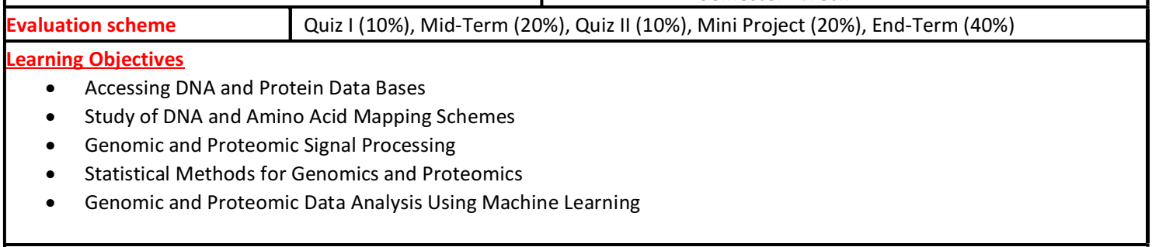
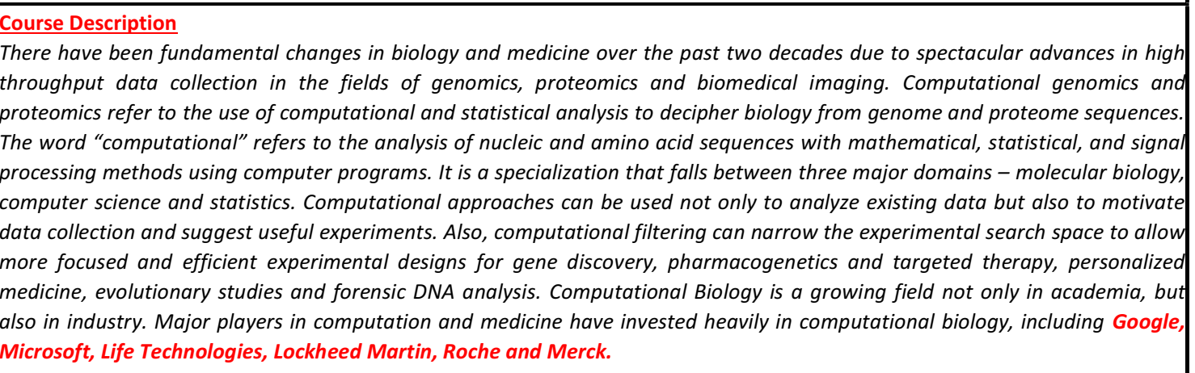

Slide 7
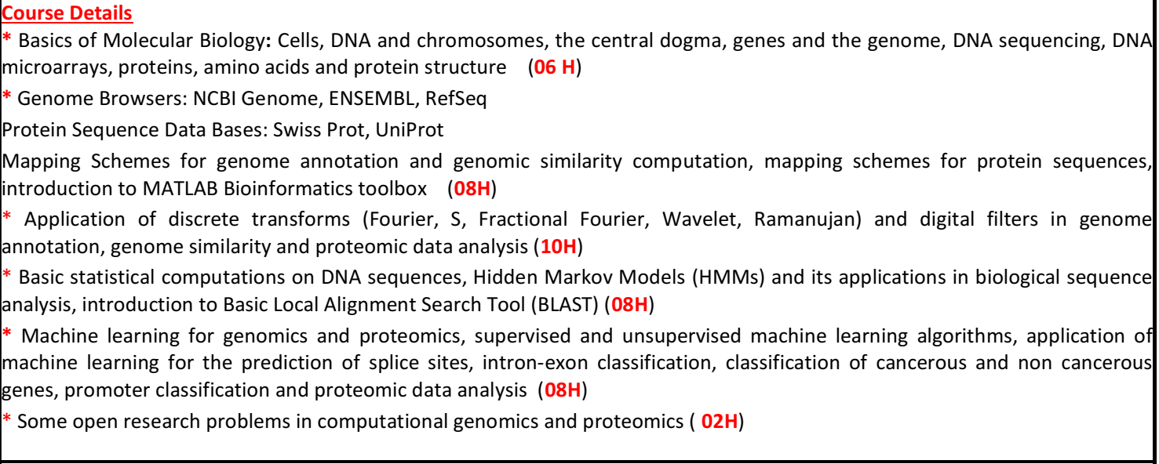
Computational Genomics & Proteomics

Slide 8
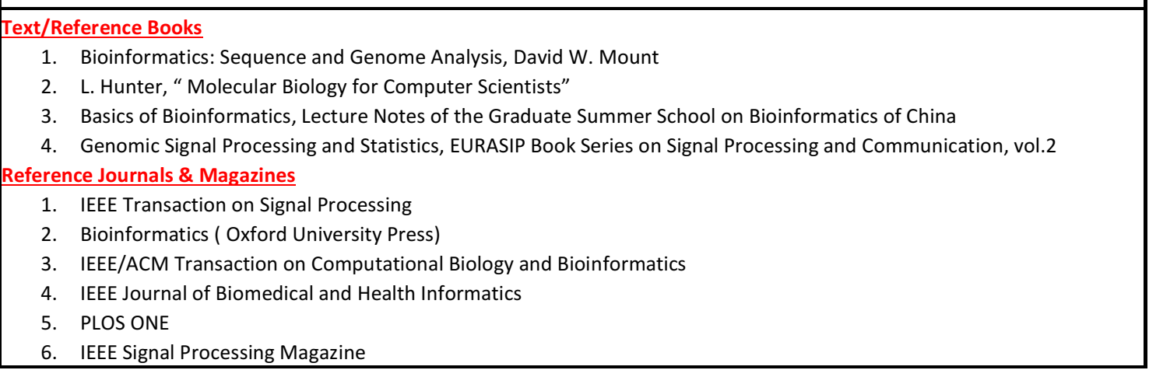
Computational Genomics & Proteomics

Slide 9
Objective/Motivation Why Computational Methods ?
Experimental methods are time consuming because of the enormity of genomic data.
Experimental methods are expensive.
The results obtained from computational methods can be used by biologists to validate and further enhance the accuracy.

Slide 10
Interdisciplinary Research
Molecular Biology + Signal Processing + Probabilistic Methods + Machine Learning + AI Tools
Computational Biology
Bio-Informatics
DNA Data Mining
Programming Languages
PERL/R/Python/MATLAB

Slide 11
Molecular Biology Basics

Slide 12
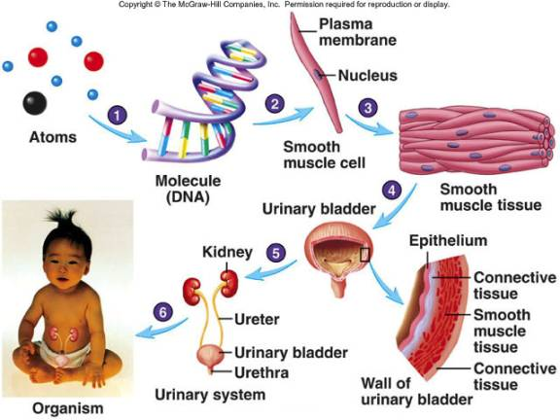
From DNA to Body
DNA
Chromosomes
Nuclei
Cells
Tissues
Organs
Systems
Body

Slide 13
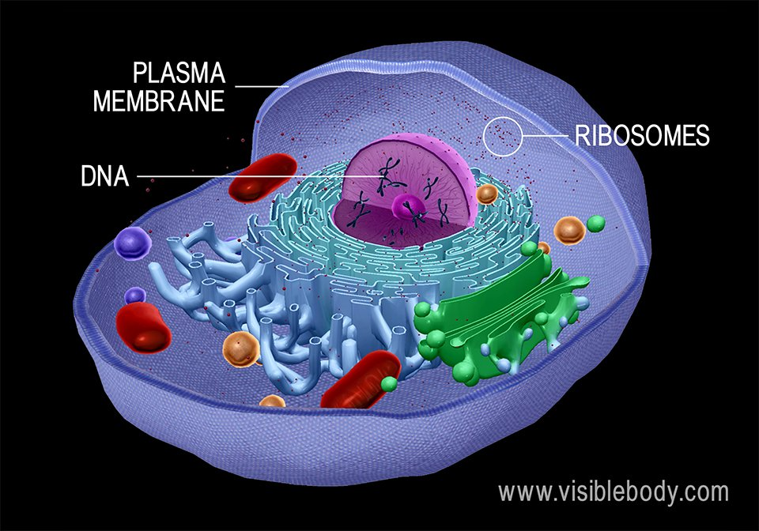

Slide 14
Procaryotes & Eucaryotes
Single-celled organisms like bacteria do not have a nucleus and the DNA just resides in the cell. Such cells are called procaryotes;
higher organisms (worms, insects, plants, mammals,... ) have cells with nucleus and are called eucaryotes. These have the DNA residing in the nucleus. An exception is the red blood cell which has no nucleus.

Slide 15
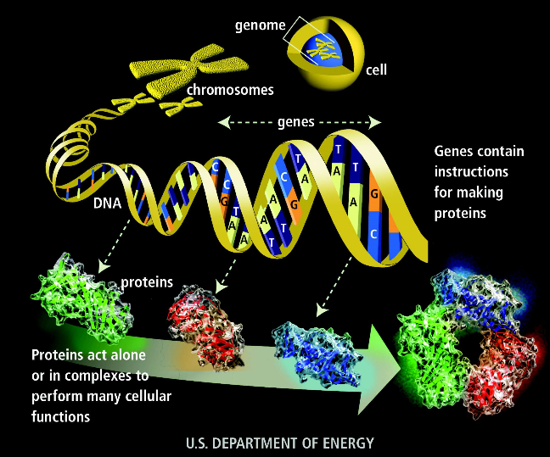

Slide 16
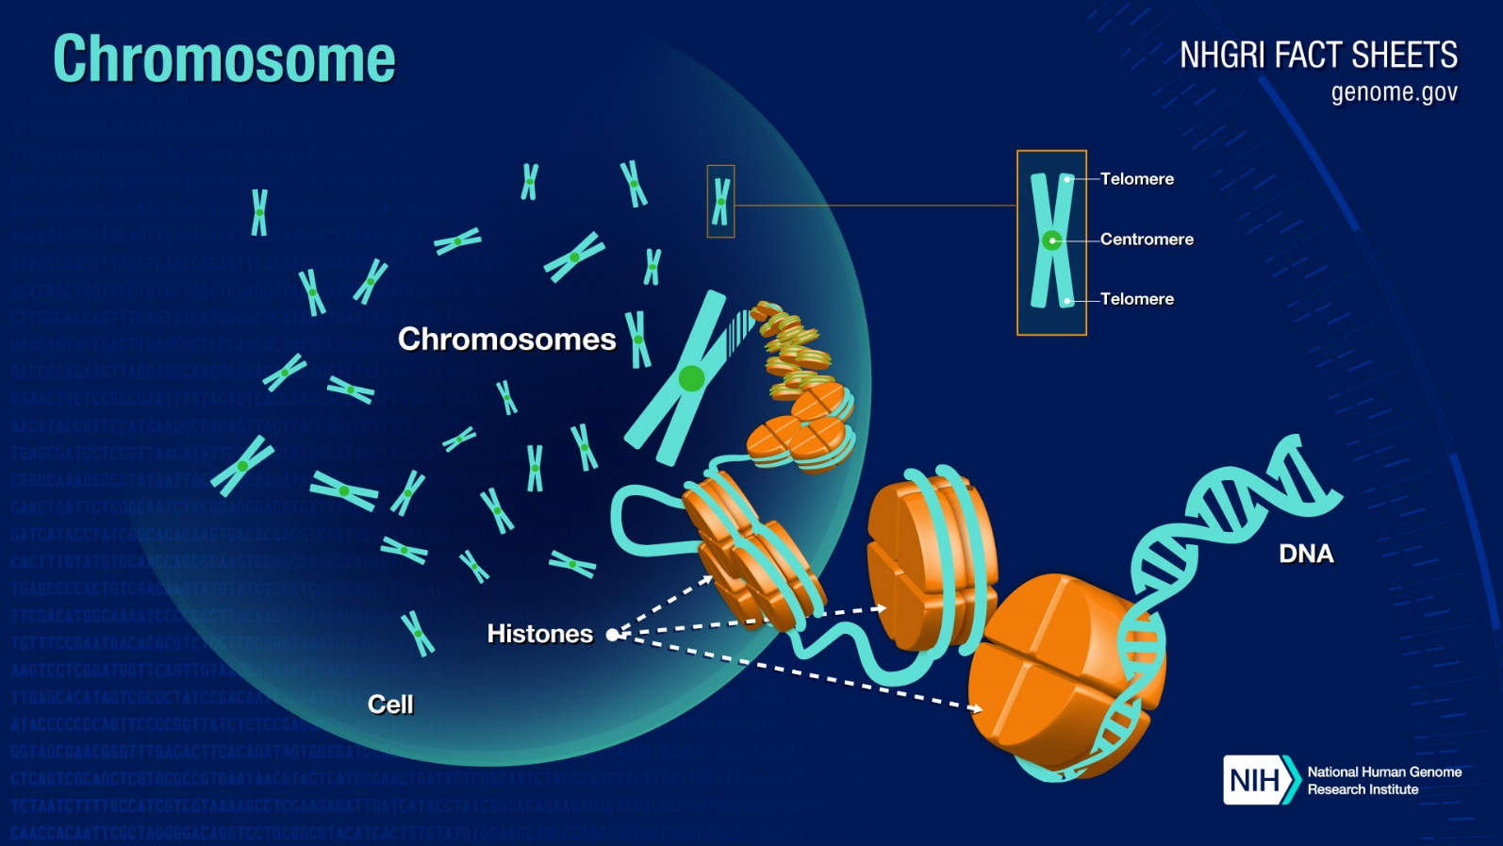
The human genome is arranged in 23 chromosomes, with the total length of about 3 billion bp (3×10⁹ bp). A normal human cell contains 23 pairs of chromosomes, with two copies of chromosomes 1-22, and two copies of X chromosomes in female or one copy of X and one copy of Y in males

Slide 17
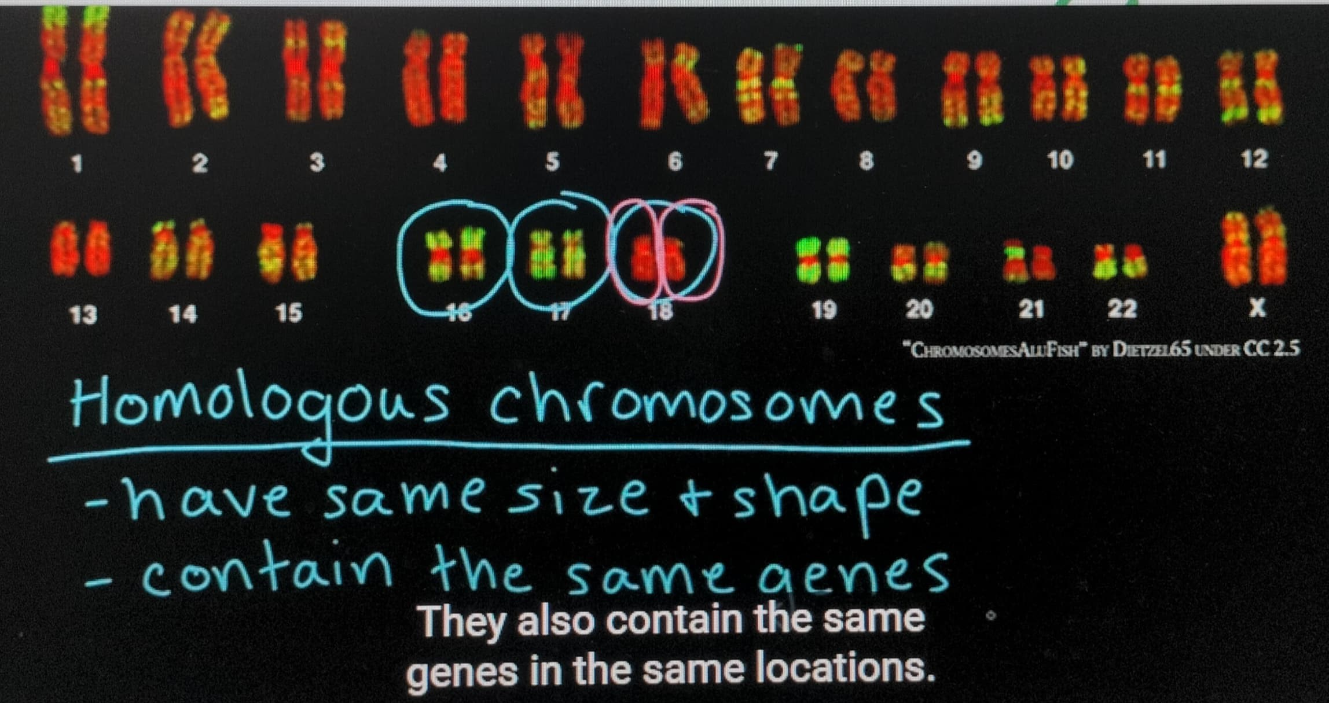

Slide 18
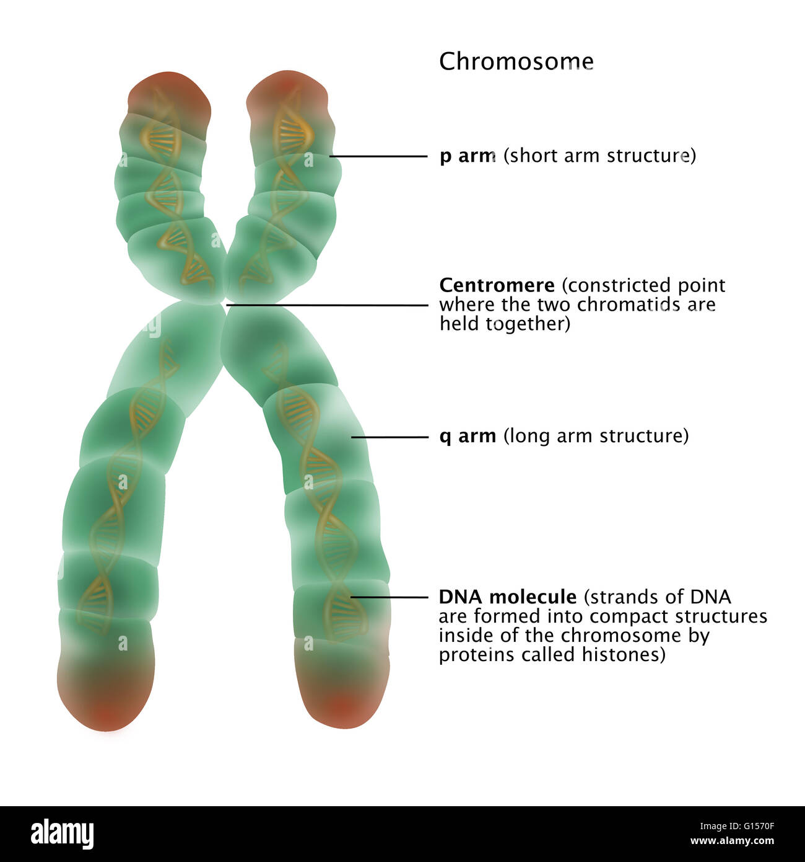

Slide 19
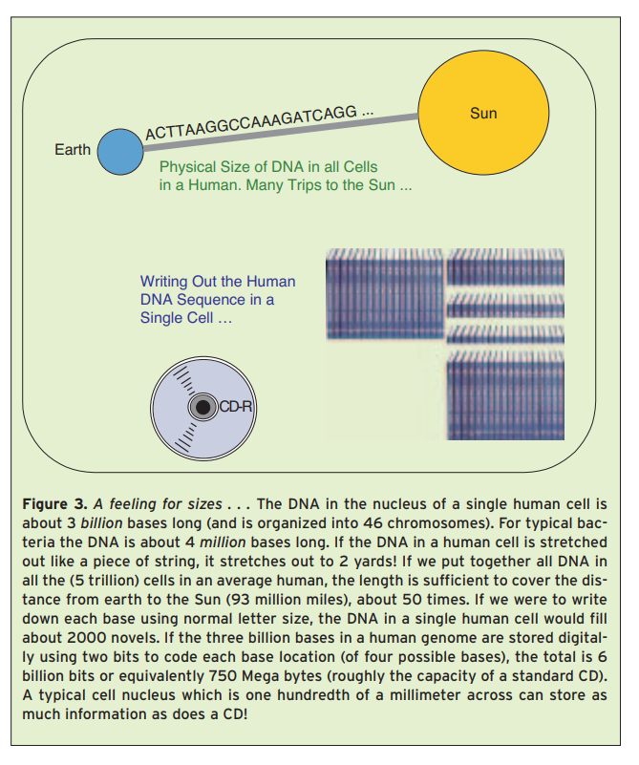
Big Data

Slide 20
The History of DNA Timeline
1953: Double Helix Structure of DNA Model
1975: Sanger Sequencing to Identify Each of the Four Nucleic Acids That Make up DNA
Human Genome Project: Initiated – 1990; Completed - 2003
Next Generation Sequencing : Beginning of the 21

Slide 21
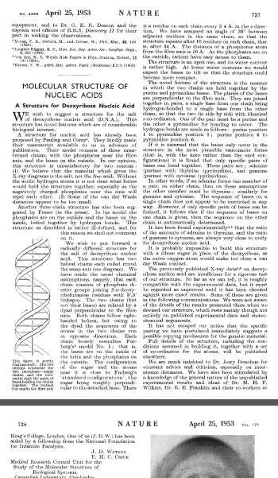
DNA Model of Watson & Cricks

Slide 22
A Scientific Breakthrough
Nine years later, in 1962, Watson & Cricks shared the Nobel Prize in Physiology or Medicine with Maurice Wilkins. Half a century later, important new implications of this contribution to science are still coming to light.

Slide 23
Genome Sequencing
Genome Sequencing is figuring out the order of DNA nucleotides or bases in a genome – the order of As, Cs, Gs, and Ts that make up an organism’s DNA. The human genome is made up of over 3 billion of these genetic letters. Sequencing an entire genome is mostly done by high-tech machines
AGTCCGCGAATACAGGCTCGGT………
After sequencing Scientists have to translate those strings of letters into an understanding of how the genome works: what the various genes that make up the genome do, how different genes are related, and how the various parts of genome are coordinated

Slide 24
Human Genome Project
The HGP aimed to map the nucleotides contained in a human reference genome ( more than three billion).
The project was formally launched in 1990 by the US Govt. and was declared complete on April, 2003.
Funding came from the US Govt. through the NIH as well as numerous other groups from around the world.
Sequencing was performed in twenty universities and research centers in the US, the UK, Japan, France, Germany, Spain and China.
The genome of any given individual is unique; mapping the human genome involved a small number of individuals and then assembling these together to get a complete sequence for each chromosome. Therefore, the finished human genome is a mosaic, not representing any one individual.
There may probably be something like 18,000 to 20,000 genes in human body.

Slide 25
Sequencing Machines
Small-scale PCR (Polymerase Chain Reaction) and Sanger sequencing (1977, Frederick Sanger) have been replaced by NGS machines.
NGS became available at the beginning of the 21st century. Perhaps the biggest advance that NGS offered was the ability to produce a huge amount of data, alongside its ability to provide a highly efficient, rapid, low-cost approach and accurate DNA sequencing, beyond the reach of traditional Sanger methods.
Illumina controls 75% of this market with its closest competitor Thermo Fisher.

Slide 26
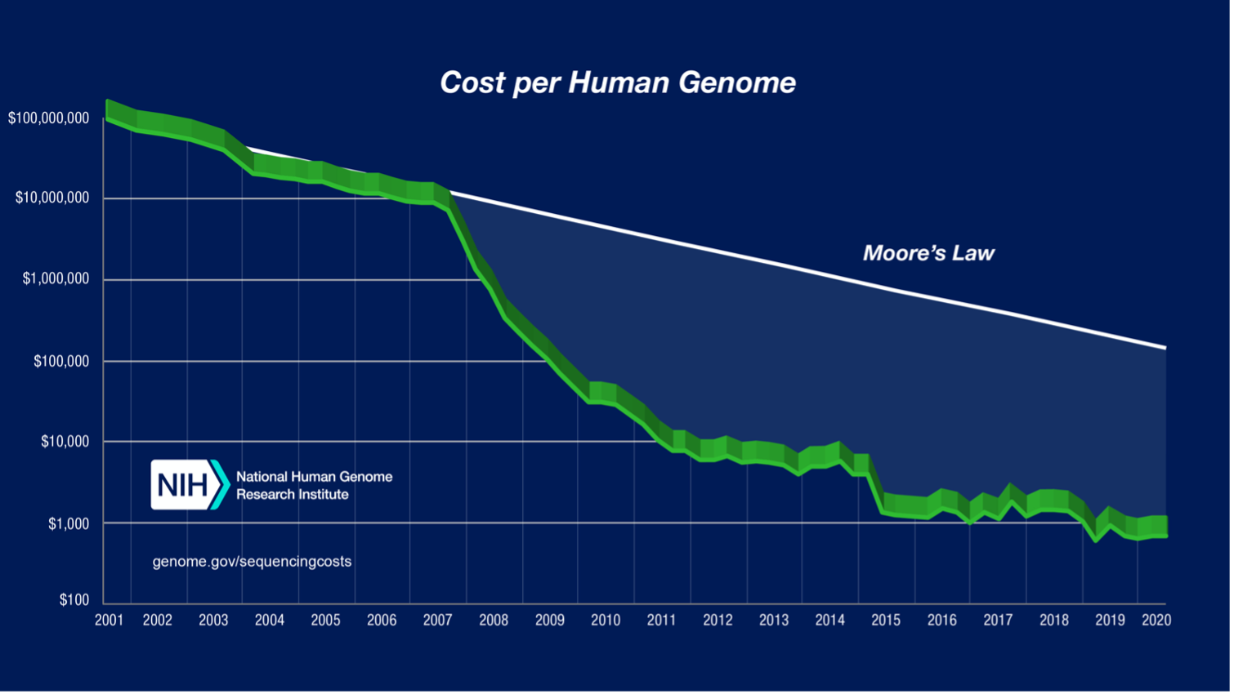

Slide 27
Whole genome sequencing is available in India, and it can cost approximately 25,000 Rs ($338 USD) to 50,000 Rs ($676 USD). A large-scale genomics project called IndiGen is currently taking place with the objective of sequencing the DNA of thousands of volunteers to determine common genetic traits and combat the incidence of rare genetic diseases in the country.

Slide 28
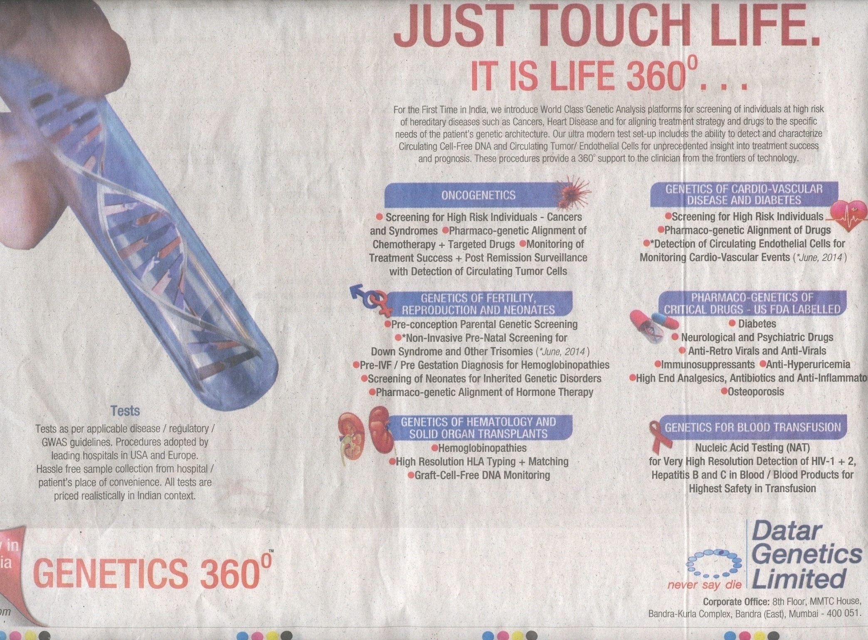

Slide 29
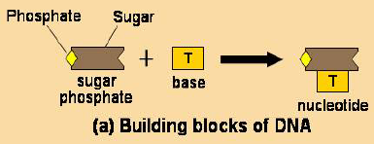
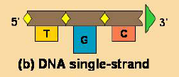
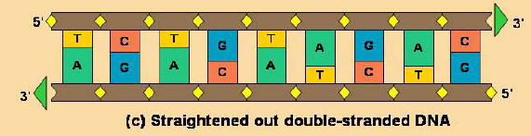
DNA & Its Building Block

Slide 30
DNA Molecule in the Living Cell
Bases or Nucleotides
A(Adenine)
T( Thymine)
C(Cytosine)
G(Guanine)
About 3 billion base pairs in human DNA
A ≡ T
C≡G
Complementary Strands
Hydrogen bond

Slide 31
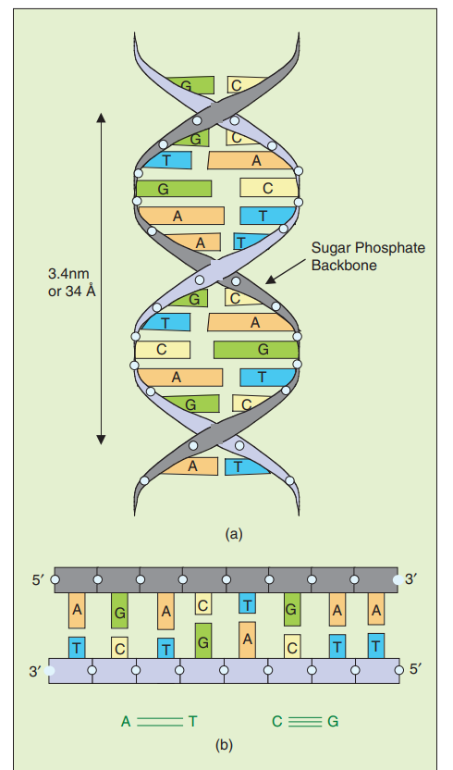

Slide 32
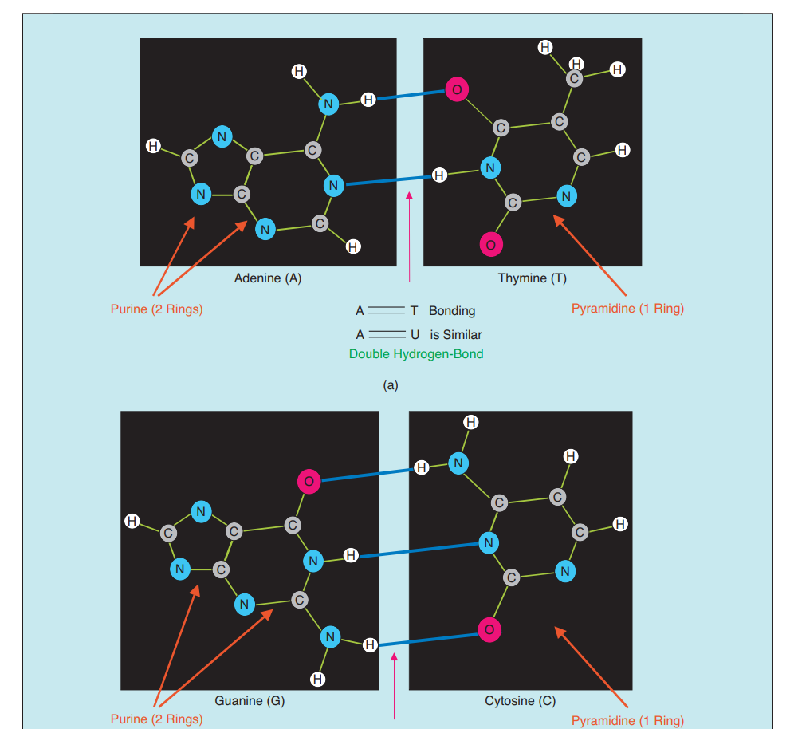

Slide 33
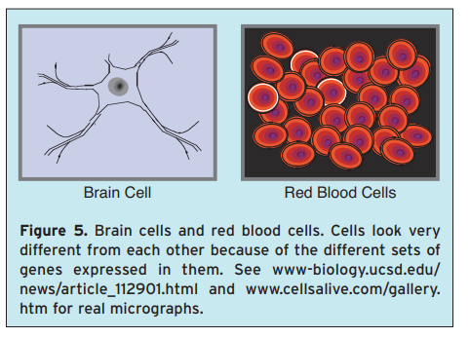

Slide 34
Central Dogma of Molecular Biology
Transcription: Genes are copied into RNA called messenger RNA (mRNA).
Translation: Proteins are then made from the mRNA transcripts.
The above two steps are fundamental to all life and hence are together called the central dogma of molecular biology.
DNA
mRNA
PROTIEN
Transcription
Translation

Slide 35
Central Dogma of Molecular Biology

Slide 36
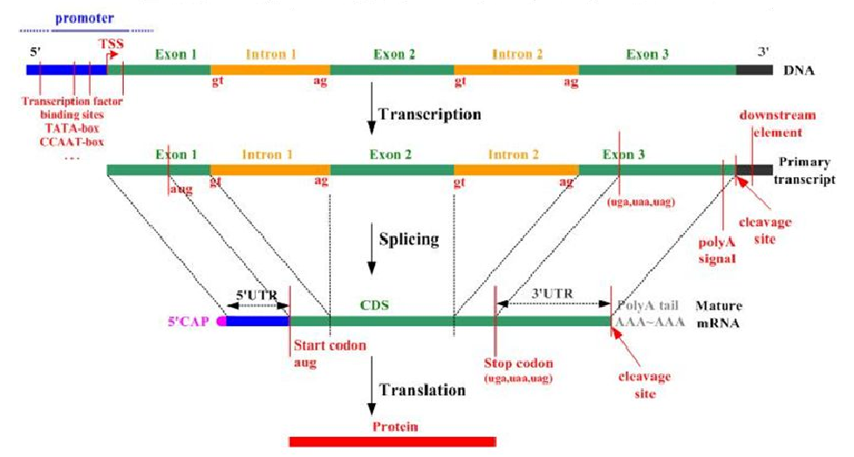
Central Dogma of Molecular Biology

Slide 37
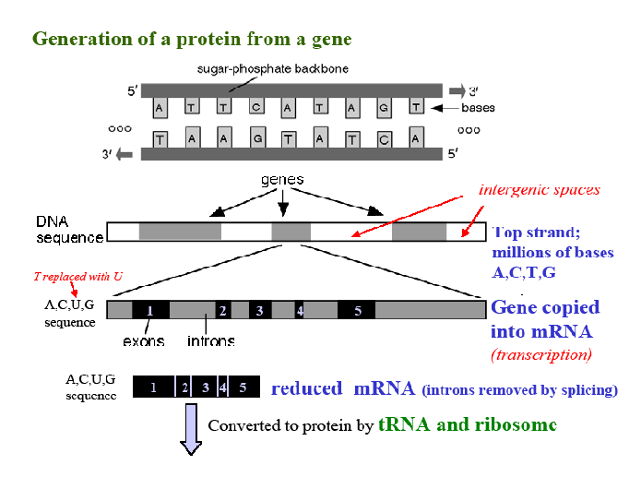

Slide 38
Transcription and Translation
The process of going from a gene encoded in DNA to a protein made up of amino acids is divided conceptually into two steps: transcription (DNA→RNA) and translation (RNA→Protein).
The cellular machine for making proteins is called the ribosome. The ribosome can take a sequence of nucleotides (RNA) and translate this string into a string of amino acids. Since the ribosome cannot work directly from the double-stranded DNA sequence found in chromosomes, the cell must create a workable copy of this DNA that can be delivered to the ribosome.
So the cell transcribes the DNA encoding genes into messenger RNA (mRNA).
The mRNA sequence transcribed is a faithful copy of the DNA sequence: it has a one-to-one correspondence to it and the same 5 to 3 orientation. (Important exception: RNA uses the nucleotide uracil, U, in place of thymine, T.)

Slide 39
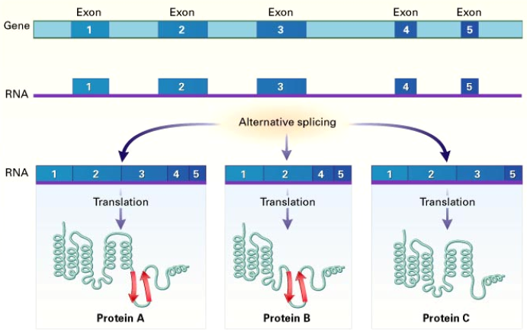
Alternative splicing

Slide 40
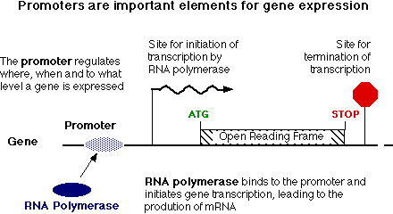
What are Promoters ?
A promoter is a regulatory region of DNA located upstream (towards the 5' region) of of a gene, providing a control point for regulated gene transcription.

Slide 41
Promoters
Prokaryotic promoters
In prokaryotes, the promoter consists of two short sequences at -10 and -35 positions upstream from the transcription start site.
The sequence at -10 is called the Pribnow box, or the -10 element, and usually consists of the six nucleotides TATAAT. The Pribnow box is absolutely essential to start transcription in prokaryotes.
The other sequence at -35 (the -35 element) usually consists of the six nucleotides TTGACA. Its presence allows a very high transcription rate.
Eukaryotic promoters
Eukaryotic promoters are extremely diverse and are difficult to characterize. They typically lie upstream of the gene and can have regulatory elements several kilobases away from the transcriptional start site. In eukaryotes, the transcriptional complex can cause the DNA to bend back on itself, which allows for placement of regulatory sequences far from the actual site of transcription. Many eukaryotic promoters, contain a TATA box (sequence TATAAA), which in turn binds a TATA binding protein which assists in the formation of the RNA polymerase transcriptional complex. The TATA box typically lies very close to the transcriptional start site (often within 50 bases).

Slide 42
Enhancers
Eukaryotic enhancers are DNA sequences that act as regulatory elements to boost gene transcription, often located far from the gene they influence. They work by binding transcription factors, which then interact with the promoter region and RNA polymerase, ultimately increasing the rate of gene expression.
Location: Enhancers can be located upstream, downstream, or even within the gene they regulate, and can be quite distant from the promoter.
Independence: They are not dependent on their orientation or precise distance from the promoter.
Specificity: Enhancers often confer tissue-specific and temporal (time-specific) regulation of gene expression.
Increased Transcription: By facilitating the recruitment and activity of RNA polymerase, enhancers increase the rate at which the gene is transcribed into mRNA.
Disease: Dysregulation of enhancers can lead to various human diseases due to improper gene expression

Slide 43
What is Genome Analysis?
Genome analysis entails the prediction of genes in uncharacterized genomic sequences. The 21st century has seen the announcement of the draft version of the human genome sequence. Model organisms have been sequenced in both the plant and animal kingdoms.
However, the pace of genome annotation is not matching the pace of genome sequencing. Experimental genome annotation is slow and time consuming. The demand is to be able to develop computational tools for gene prediction.
Computational Gene prediction is relatively simple for the prokaryotes where all the genes are converted into the corresponding mRNA and then into proteins. The process is more complex for eukaryotic cells where the coding DNA sequence is interrupted by random sequences called introns.
Some of the questions which biologists want to answer today are:
Given a DNA sequence, what part of it codes for a protein and what part of it is junk DNA.
Classify the junk DNA as intron, untranslated region, transposons, dead genes, regulatory elements etc.
Divide a newly sequenced genome into the genes (coding) and the non-coding regions.
The importance of genome analysis can be understood by comparing the human and chimpanzee genomes. The chimp and human genomes vary by an average of just 2% i.e. just about 160 enzymes. A complete genome analysis of the two genomes would give a strong insight into the various mechanisms responsible for the differences.

Slide 44
DNA ANNOTATION (Structural & Functional)
In molecular biology and genetics, DNA annotation or genome annotation is the process of describing the structure and function of the components of a genome, by analyzing and interpreting them in order to extract their biological significance and understand the biological processes in which they participate.
Among other things, it identifies the locations of genes and all the coding regions in a genome and determines what those genes do.

Slide 45
DNA ANNOTATION
Annotation is performed after a genome is sequenced and assembled, and is a necessary step in genome analysis before the sequence is deposited in a database and described in a published article.
Due to the size and complexity of sequenced genomes, DNA annotation is not performed manually, but is instead automated by computational means. However, the conclusions drawn from the obtained results require manual expert analysis.
DNA annotation is classified into two categories: structural annotation, which identifies and demarcates elements in a genome, and functional annotation, which assigns functions to these elements.

Slide 46
STRUCTURAL ANNOTATION
Structural annotation describes the precise location of the different elements in a genome, such as open reading frames (ORFs), coding sequences (CDS), exons, introns, repeats, splice sites, regulatory motifs, start and stop codons, and promoters.^{[6][23]} The main steps of structural annotation are:
Repeat identification and masking.
Evidence alignment (optional).
Splice identification (only in eukaryotes).
Feature prediction (coding and noncoding sequences).

Slide 47
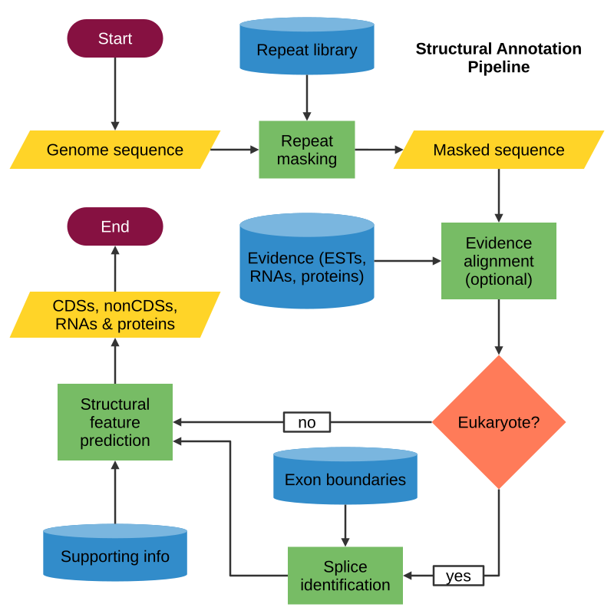
STRUCTURAL ANNOTATION

Slide 48
Repeat Identification and Masking
The first step of structural annotation consists in the identification and masking of repeats, which include low-complexity sequences (such as AGAGAGAG, or monopolymeric segments like TTTTTTTTT), and transposons (some repetitive elements are able to move within the genome (transposons and retrotransposons). DNA transposons move from one genomic location to another by a cut-and-paste mechanism).
Repeats are a major component of both prokaryotic and eukaryotic genomes; for instance, between 0% and over 42% of prokaryotic genomes consist of repeats and three quarters of the huma genome are composed of repetitive elements.
After the repetitive regions in a genome have been identified, they are masked. Masking means replacing the letters of the nucleotides (A, C, G, or T) with other letters. By doing so, these regions will be marked as repetitive and downstream analyses will treat them accordingly. Repetitive regions may produce performance issues if they are not masked, and may even produce false evidence for gene annotation
Depending on the letters used for replacement, masking can be classified as soft or hard: in soft masking, repetitive regions are indicated with lowercase letters (a, c, g, or t), whereas in hard masking, the letters of these regions are replaced with N's.

Slide 49
Repeat Identification Methods
De novo methods. Repeats are identified by detecting and grouping pairs of sequences at different locations whose similarity is above a minimum threshold of sequence conservation in a self-genome comparison, thus requiring no prior information about repeat structure or sequences.
Homology-based methods. Repeats are identified by similarity (homology) of known repeats stored in a curated database. These methods are more likely to find real transposons, even in lower quantities, when compared with de novo methods, but are biased towards previously identified families.
Structure-based methods. Repeats are identified based on models of their structure, rather than repetition or similarity. They are capable of identifying real transposons (just like the homology-based ones), but are not biased by known elements.

Slide 50
Evidence Alignment
The next step after genome masking usually involves aligning all available transcript and protein evidences with the analyzed genome, that is, aligning all known expressed sequence tags (ESTs are short DNA sequences derived from expressed genes (genes that are transcribed into mRNA)., RNAs and proteins of the organism being annotated with the genome.
Although it is optional, it can improve gene sequence elucidation because RNAs and proteins are direct products of coding sequences.

Slide 51
Splice Site Identification
Annotation of eukaryotic genomes has an extra layer of difficulty due to RNA splicing, a post-transcriptional process in which introns (non-coding regions) are removed and exons (coding regions) are joined. Therefore, eukaryotic coding sequences (CDS) are discontinuous, and, to ensure their proper identification, intronic regions must be filtered. To do so, annotation pipelines must find the exon-intron boundaries, and multiple methodologies have been developed for this purpose.
One solution is to use known exon boundaries for alignment; for instance, many introns begin with GT and end with AG. This approach, however, cannot detect novel boundaries, so alternatives like machine learning algorithms exist that are trained on known exon boundaries and quality information to predict new ones.

Slide 52
Feature Prediction
A genome is divided in coding and noncoding regions, and the last step of structural annotation consists in identifying these features within the genome.
In fact, the primary task in genome annotation is gene prediction, which is why numerous methods have been developed for this purpose.
Gene prediction is a misleading term, as most gene predictors only identify coding sequences (CDS) and do not report untranslated regions (UTRs); for this reason, CDS prediction has been proposed as a more accurate term.
CDS predictors detect genome features through methods called sensors, which include signal sensors that identify functional site signals such as enhancers, promoters and polyA sites, and content sensors that classify DNA sequences into coding and noncoding content.

Slide 53
Feature Prediction Methods
Ab initio methods (also called statistical, intrinsic, or de novo). CDS prediction is based solely on the information that can be extracted from the DNA sequence. They rely on statistical methods such as the hidden Markov model (HMM).
Homology-based methods (also called empirical, evidence-driven, or extrinsic). CDS prediction is based on similarity to known sequences. Specifically, it performs alignments of the analyzed sequence with expressed sequence tags (ESTs), complementary DNA (cDNA), or protein sequences.
Combiners CDS prediction is done by a combination of both methods mentioned above.

Slide 54
Non-Coding RNAs
Over the years, number of RNAs that do not function as messenger RNAs (mRNAs), transfer RNAs (tRNAs), or ribosomal RNAs have been discovered.
mRNAs are translated into proteins and ncRNAs have little or no coding potential but are involved in transcriptional regulatory mechanisms.
ncRNAs are further categorized as short ncRNAs( < 200 nt) which include microRNAs (miRNAs- typically 21-23 nucleotides long), small RNAs (sRNA), piwi-interacting RNAs (piRNAs), small interfering RNAs (siRNAs), and long non-coding RNAs (> 200 nt).
lncRNAs are present in either nucleus or cytoplasm, and they can interact with DNA, RNA or protein. Through this, they modulate the expression and stability of their downstream targets at epigenetic (heritable changes in gene expression that occur without altering the underlying DNA sequence), transcriptional and post-transcriptional levels
lncRNAs are known to have more developmental stage-,tissue-, organ- and disease-specific expression patterns than protein-coding genes.
With increasing attention to the roles of lncRNAs as oncogenes and tumor suppressors in cancers, lncRNAs have exhibited superior potential as diagnostic and prognostic biomarkers than protein-coding genes owing to the more closely association between lncRNA expression and their functions. Recent studies have reported several lncRNA-focus signatures to improve prognosis prediction for some malignant tumors including breast cancer, lung cancer, colorectal cancer and so on.

Slide 55
Epigenetics
Epigenetics is the study of heritable changes in gene expression that occur without altering the
underlying DNA sequence. Essentially, it's about how our genes are "read" and used, which can
be influenced by our environment and behaviors, even though the DNA itself remains the same.
These changes can affect how our cells function and can even be passed on to future generations.
Beyond the DNA sequence: While our DNA sequence (the order of A, T, C, and G) is fixed, the way that DNA
is packaged and used can change.
Chemical tags: Epigenetics involves chemical modifications (like methylation and histone modifications) that
attach to DNA and proteins associated with DNA (like histones).
Turning genes on and off: These modifications can either activate or deactivate genes, affecting how much
of a particular protein is produced.
Environmental influence: Our diet, lifestyle, exposure to toxins, stress, and even our social experiences can
all impact these epigenetic modifications.
Not mutations: Epigenetic changes are distinct from mutations, which involve changes in the DNA sequence
itself. Epigenetic changes are often reversible and can be influenced by the environment

Slide 56
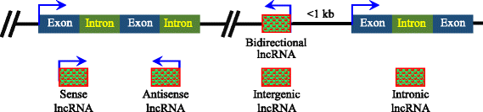
Classification of lncRNAs
Sense lncRNA: transcribed from the sense strand of a protein coding gene, usually overlapping the introns or exons of the sense strand;
Antisense lncRNA: transcribed from the antisense strand of a protein coding gene
Intergenic lncRNA (lincRNAs): transcribed from the space between two protein coding genes;
Intronic lncRNA: transcribed from the intronic regions between the exomes of a gene;
Bidirectional lncRNA: transcribed in an opposite direction with respect to the nearby protein coding gene and located within 1 kb of the promoter of the protein coding gene. Transcribed from both sense and antisense directions of TS

Slide 57
Long non-coding RNAs & Complex Diseases
Only a limited number of lncRNAs have been experimentally reported to be related to human diseases.
Disease Biomarkers - Analyzing available lncRNA-disease associations and predicting potential human lncRNA-disease associations have become important tasks of bioinformatics.
Pathophysiology – Understanding human complex diseases mechanism at lncRNA level
Prognosis – A prediction of how a condition will unfold over time using lncRNAs.
Diagnosis – The process of identifying a disease or a condition using lncRNAS. A diagnosis is made before prognosis. If a patient has a broken ankle, their diagnosis is a broken ankle. Their prognosis might be that they'll need six weeks to heal before the cast can be removed, followed by six weeks of physical therapy.
CHAST & ANRIL can be used as diagnostic biomarkers for precision diagnostics in the context of Heart Failure.
Therapeutics – lncRNAs can be used to adopt a tailored therapy strategy resulting in the most favorable outcomes. The optimization of therapeutic effectiveness and the reduction of undesirable effects can also be achieved by tailoring treatment regimens according to the unique lncRNA profiles of individual patients.
The emergence of single-cell sequencing and CRISPR-based genome editing, has the potential to expedite the investigation of lncRNA and the creation of therapeutic interventions in a safer and more specific manner.

Slide 58
lncRNAs
lncRNAs play an important role in many life activities, such as epigenetic regulation, transcriptional regulation, posttranscriptional regulation, cell cycle regulation and cell differentiation regulation.
lncRNAs are closely related to the formation and development of many diseases.

Slide 59
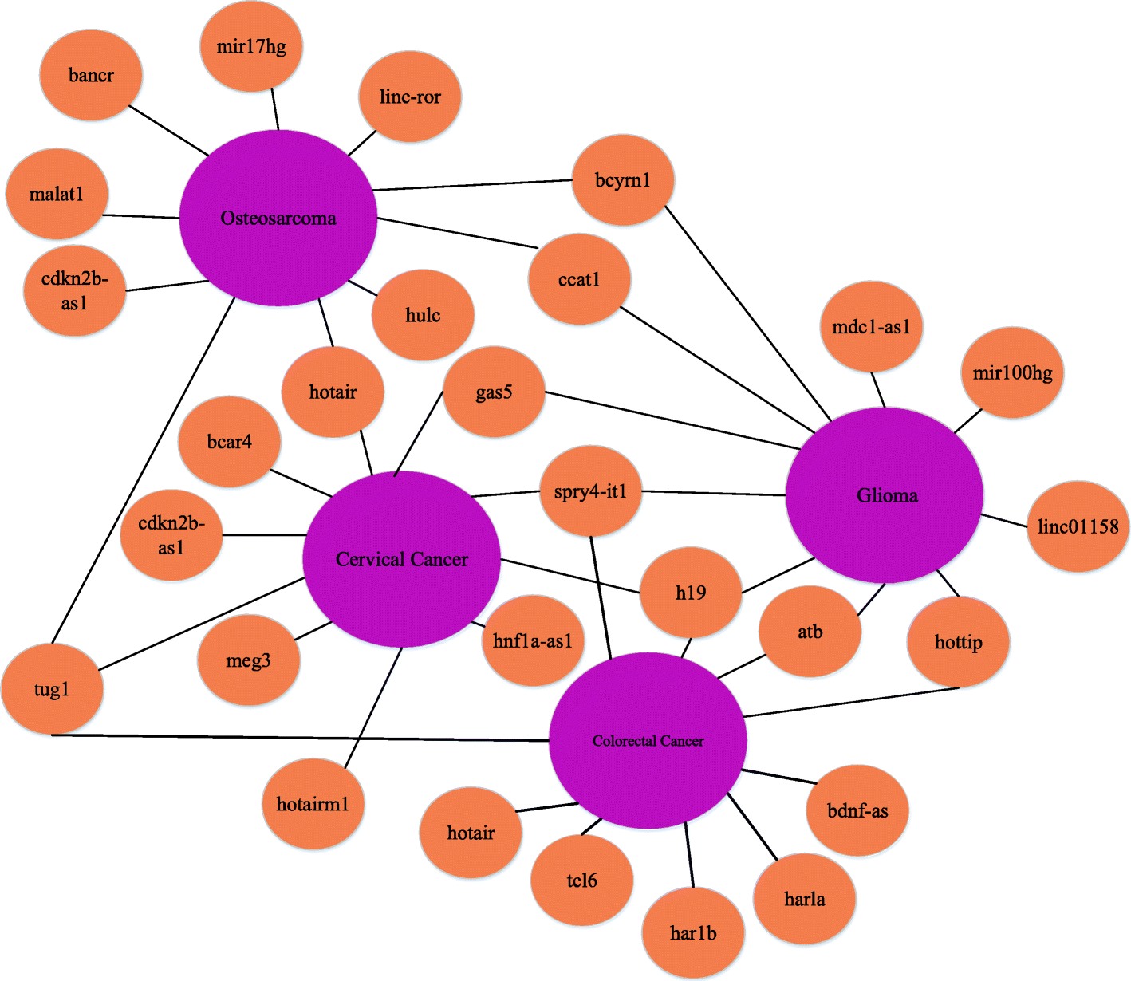
Case study of colorectal cancer, osteosarcoma, cervical cancer, and glioma. Orange nodes represent lncRNAs and purple nodes represent diseases. The top 10 scored candidate lncRNAs for each disease are linked by black edges
Zhang, Y., Ye, F., Xiong, D. et al. LDNFSGB: prediction of long non-coding rna and disease association using network feature similarity and gradient boosting. BMC Bioinformatics 21, 377 (2020). https://doi.org/10.1186/s12859-020-03721-0

Slide 60
REFERENCES
https://www.nature.com/articles/171737a0
https://en.wikipedia.org/wiki/DNA_annotation
https://www.ncbi.nlm.nih.gov/orffinder/

Slide 61
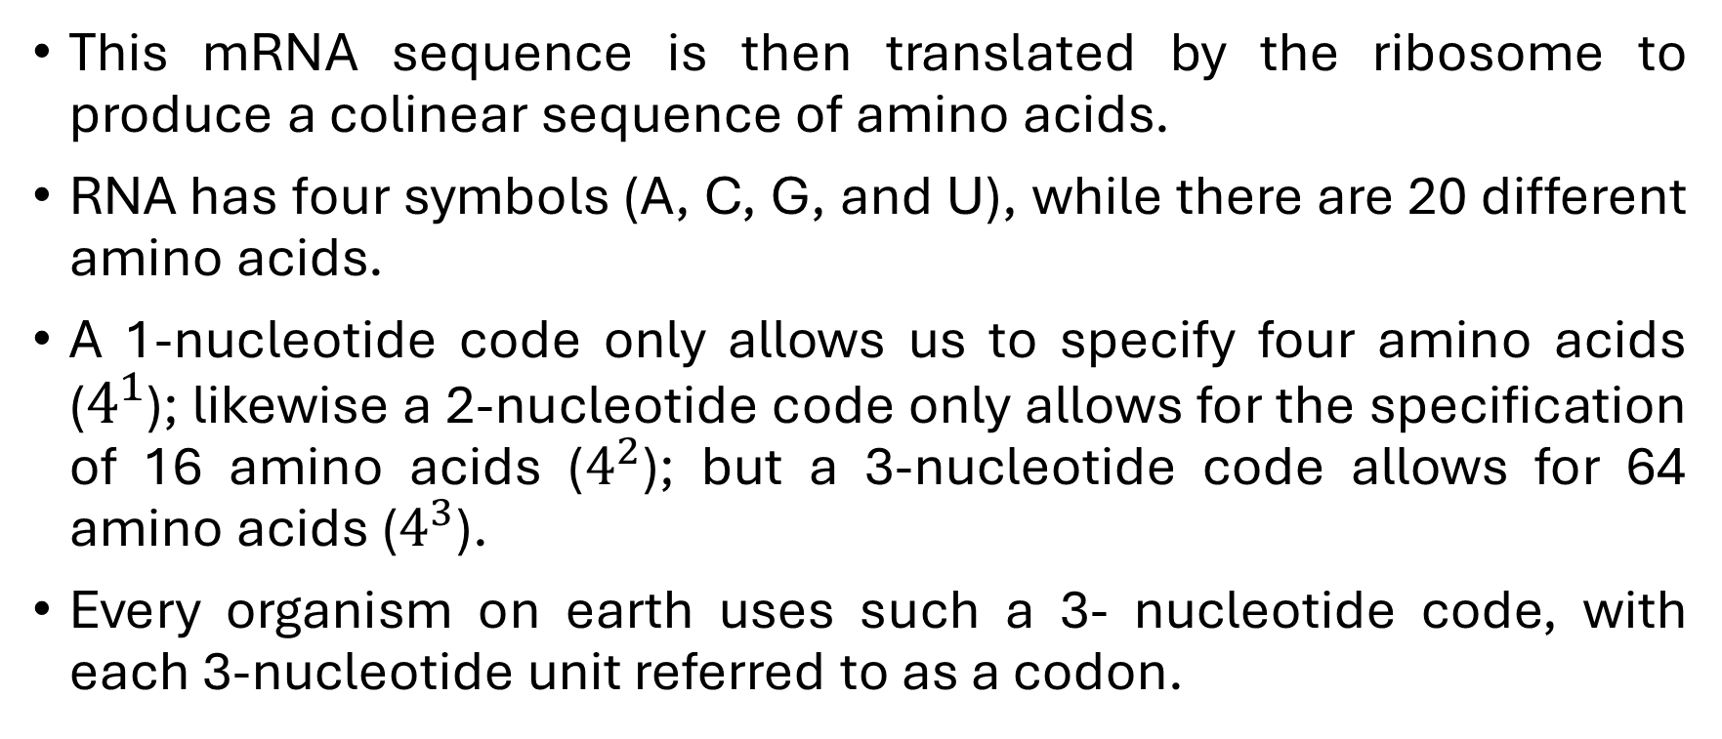
Transcription and Translation
This mRNA sequence is then translated by the ribosome to produce a colinear sequence of amino acids.
RNA has four symbols (A, C, G, and U), while there are 20 different amino acids.
A 1-nucleotide code only allows us to specify four amino acids ($4^{1}$); likewise a 2-nucleotide code only allows for the specification of 16 amino acids ($4^{2}$); but a 3-nucleotide code allows for 64 amino acids ($4^{3}$).
Every organism on earth uses such a 3- nucleotide code, with each 3-nucleotide unit referred to as a codon.

Slide 62
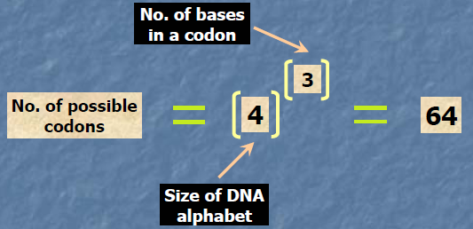
Codons
Group of three bases , called codons. It is the code for individual amino acids.
The codon sequence uniquely identifies an amino acid sequence which defines a protein.

Slide 63
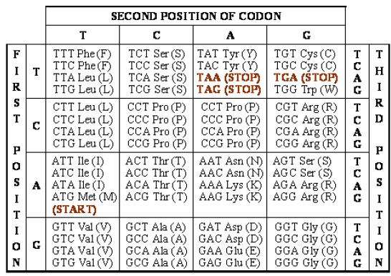

The Genetic Code
ATG acts as the only START codon (also codes for Methionine).
TAA, TAG, and TGA act as alternative codons.

Slide 64
Amino Acids
1 | A | Ala | Alanine | GCA, GCC, GCG, GCT
2 | C | Cys | Cysteine | TGC, TGT
3 | D | Asp | Aspartic acid | GAC, GAT
4 | E | Glu | Glutamic acid | GAA, GAG
5 | F | Phe | Phenylalanine1 | TTC, TTT
6 | G | Gly | Glycine | GGA, GGC, GGG, GGT
7 | H | His | Histidine2 | CAC, CAT
8 | I | IIe | Isoleucine3 | ATA, ATC, ATT
9 | K | Lys | Lysine4 | AAA, AAG
10 | L | Leu | Leucine5 | TTA, TTG, CTA, CTC, CTG, T
11 | M | Met | Methionine6 (has S) | ATG
12 | N | Asn | Asparagine | AAC, AAT
13 | P | Pro | Proline | CCA, CCC, CCG, CCT
14 | Q | Gin | Glutamine | CAA, CAG
15 | R | Arg | Arginine7 | AGA, AGG, CGA, CGC, GG, GT
16 | S | Ser | Serine | AGC, AGT, TCA, TCC, TCG, TCT
17 | T | Thr | Threonine8 | ACA, ACC, ACG, ACT
18 | V | Val | Valine9 | GTA, GTC, GTG, GTT
19 | W | Trp | Tryptophan10 | TGG
20 | Y | Tyr | Tyrosine11 | TAC, TAT

Slide 65
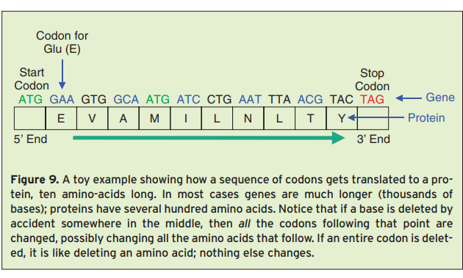

Slide 66
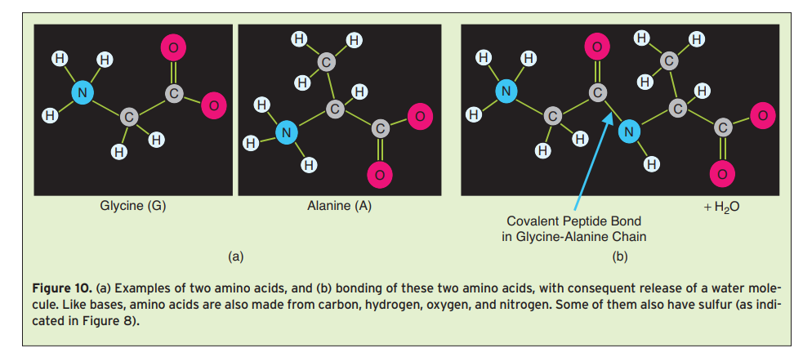

Slide 67
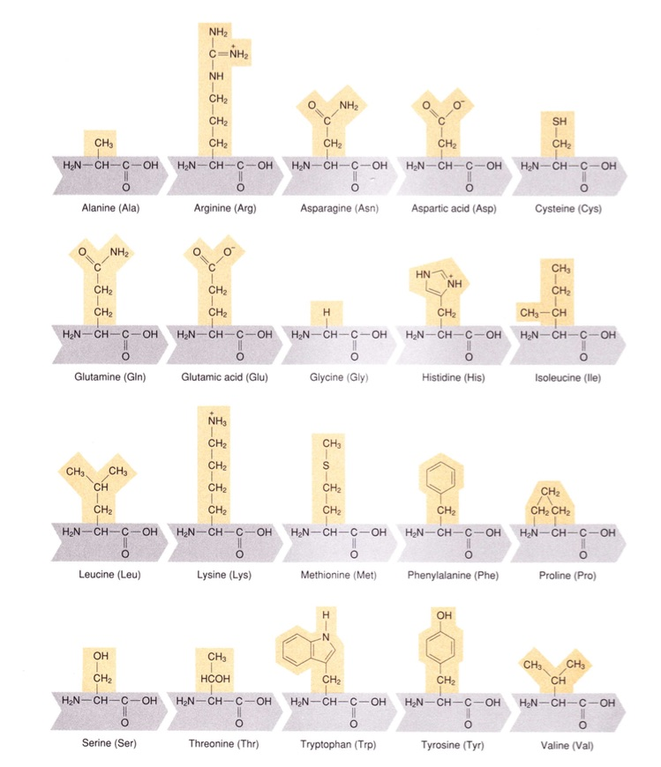

Slide 68
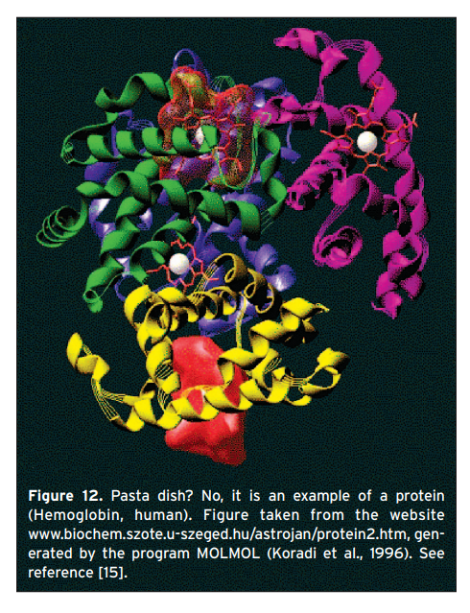

Slide 69
The Genetic Code
The genetic code. In this example we see how a DNA sequence can be organized into codons to specify an amino acid sequence. Note that different codons can specify the same amino acid.
DNA CTT GTG CCC GGC TGC GGC GGT TGT ATC CTG
Protein L V P G C G G C I L

Slide 70
Reading Frames
There are both 5 and 3 untranslated regions (UTRs) that flank the sequence to be translated into protein. As a result, the translational machinery must know exactly where on the mRNA to start working. And depending on where one starts reading a DNA sequence, there are three different ways to decompose it into codons.
The sequence: ...ACGTACGTACGTACGT... can be decomposed into codons in the following ways:
...ACG-TAC-GTA-CGT-ACG-T...
...A-CGT-ACG-TAC-GTA-CGT...
...AC-GTA-CGT-ACG-TAC-GT...
The translation into amino acids, and hence the resulting protein, would be completely different in each of the three cases. The ribosome must therefore know where to start. We call each non-overlapping decomposition of a DNA sequence into codons a reading frame.

Slide 71
Reading Frames
The way that a gene specifies its reading frame is to begin every protein with the amino acid methionine. Because there is only one codon for methionine –ATG – the ribosome knows that the first ATG in the messenger RNA specifies both the start of translation and the reading frame for the rest of the protein; the next amino acid in the chain is given by the three nucleotides that follow ATG.
In much the same way, the ribosome does not continue to read the mRNA sequence until it runs out, but instead looks for a stop codon to tell it where to cease translation. There are three stop codons – TGA, TAA, and TAG – and any one of them specifies the end of the growing amino acid chain (unlike start codons, there is no amino acid associated with stop codons).

Slide 72
Open Reading Frame
Open reading frame. Given a sequence, s, from the alphabet N = {A, C, G, T}, we define an open reading frame (ORF) as any subsequence whose length L is a multiple of 3, starting with the start codon ATG, ending in any of the three stop codons {TAA, TAG, TGA}, with no stop codons in the middle. Internal start codons are allowed. For example, the sequence:
GTATTATTATGAAGGGCCCTTCTATAGTATGATTGAAT
contains an ORF of length 24 nt: GTATTATT.ATG.AAG.GGC.CCT.TCT.ATA.GTA.TGA.TTGAAT

Slide 73
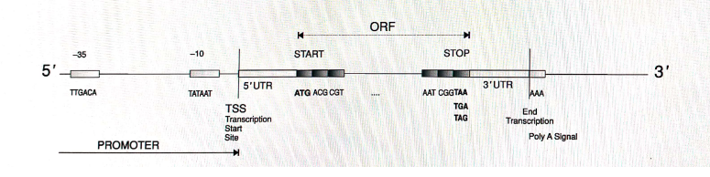
ORF

Slide 74
ORFs on the Reverse Complement of a Sequence
Because chromosomes are double-stranded, genes may be on either strand (but still in a 5 to 3 orientation). Given only one strand, we can easily reconstruct the other one by the property of complementarity. We can distinguish three reading frames on each strand for a total of six reading frames. Thus any gene-finding algorithm needs to locate ORFs on both strands, and implicitly requires that we search a second 5 to 3 sequence that is complementary to the strand given by GenBank or other DNA databases

Slide 75
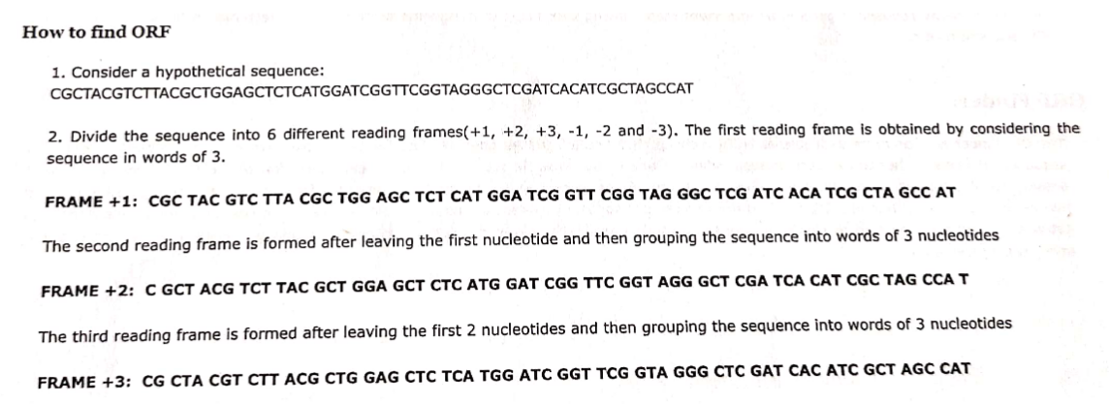

Slide 76
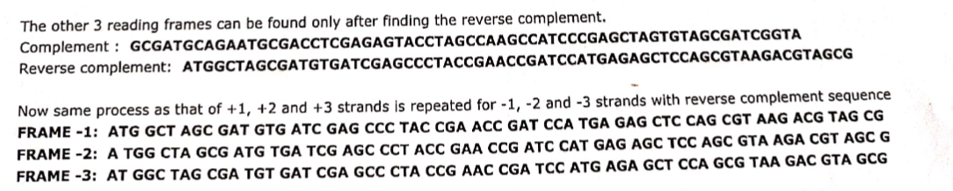

Slide 77
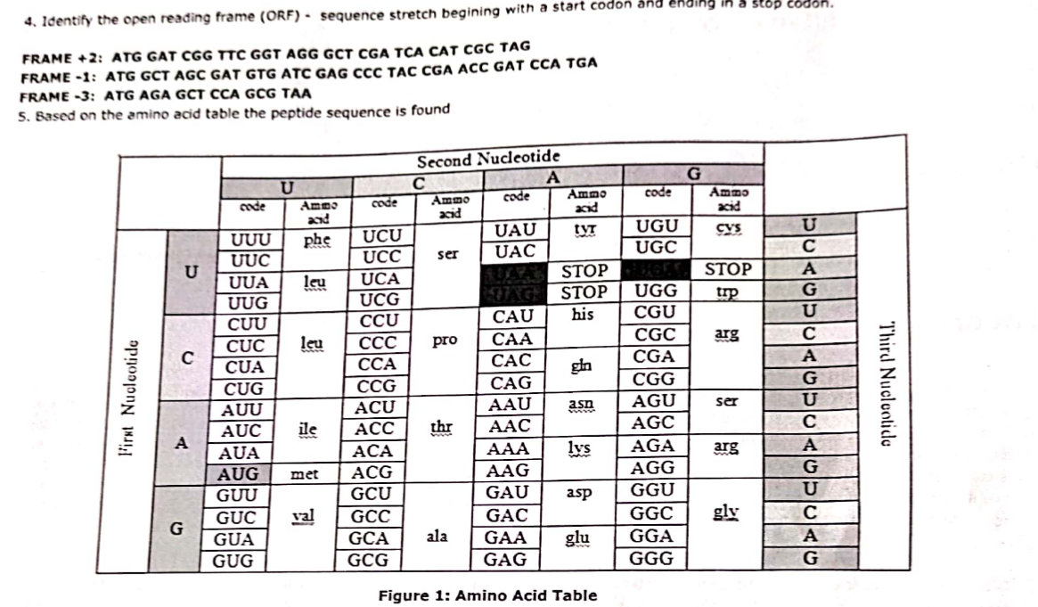

Slide 78
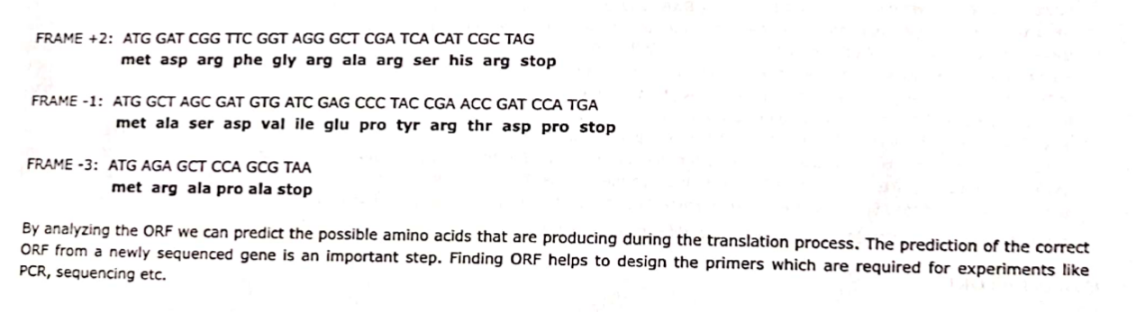

Slide 79
How long must an ORF be for us to call it a gene?
There may be many random stretches of DNA in a genome that will contain start and stop codons in the right order, just by chance.
The classic approach to deciding whether an ORF is a good candidate as a gene is to calculate the probability of seeing an ORF of length L in a random sequence (given some specific sequence probability model).
We would then make a choice as to how unlikely a given ORF has to be for us to accept it; in general, longer ORFs will be more unlikely to be due to chance.
Obviously, the more stringent our conditions, the fewer candidates we will have, and the longer they will be on average.

Slide 80
DNA Basics: Are You an Equal Mix of Mom and Dad?
Humans have 23 pairs of chromosomes, or 46 total. We each inherit a full set of 23 from our mother and another full set from our father. Twenty-two of those chromosome pairs are, for our purposes, identical; the one we get from mom is the same size and composition as the one we get from dad. This is the autosomal DNA (atDNA) used the most in genetic genealogy
The 23rd pair is more interesting. The so-called sex chromosomes, X and Y, are very different in size. The X is much larger. They also have different numbers of genes. Genetic women have two copies of the X, one from each parent. A genetic man, on the other hand, has one X, inherited from his mother, and one Y, from his father. Because the X and Y are different sizes, men inherit slightly more DNA from their mothers than from their fathers.

Slide 81
MUTATIONS
During cell division , changes happen in genes, which are called mutations.
When these mutations occurs in tumor suppressor genes, oncogenes, suicide genes & DNA repair genes, then there is a great possibility of occurrence of cancer.
Mutations
Somatic
Mutations
(Acquired
Mutations)
Germ-line
Mutations

Slide 82
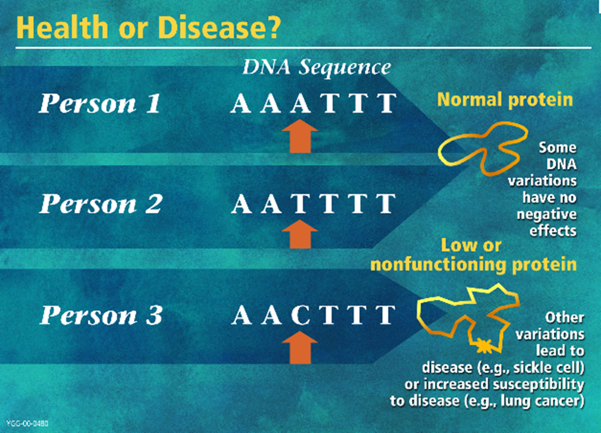
Mutations

Slide 83
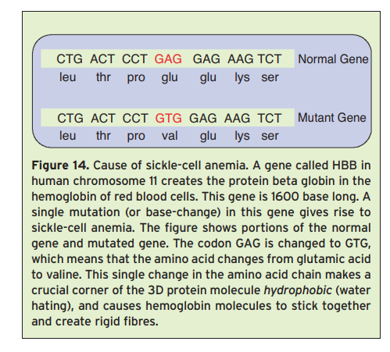

Slide 84
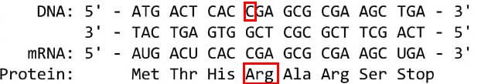
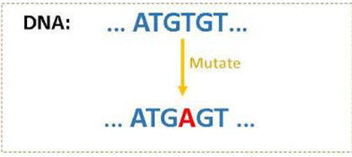
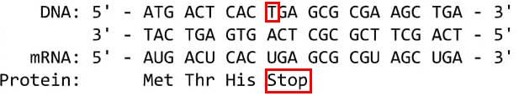
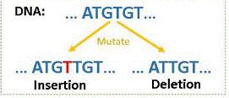
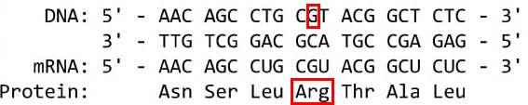
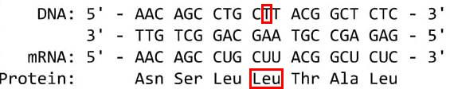
Somatic Mutation Types
Substitution
Nonsense
Ori
Example
Missense
Mut
Somatic
Mutation
Insertion
Example
Complex
Ori
Multiple insertions, deletions & Substitutions
Deletion
Mut

Slide 85
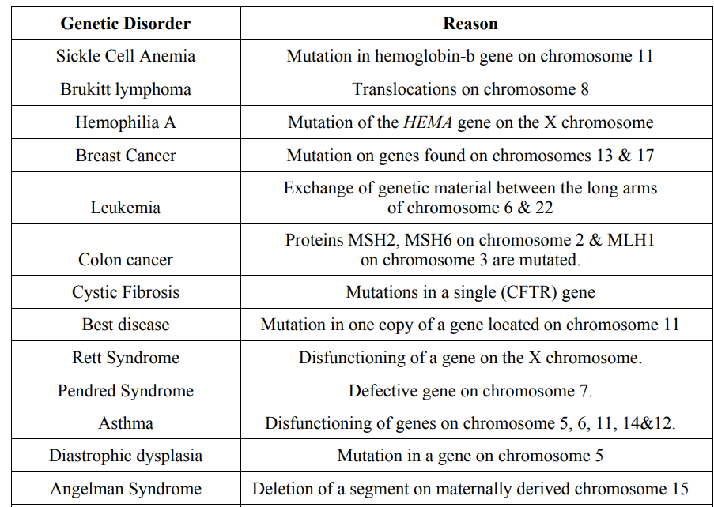
Specific Genetic Disorders

Slide 86
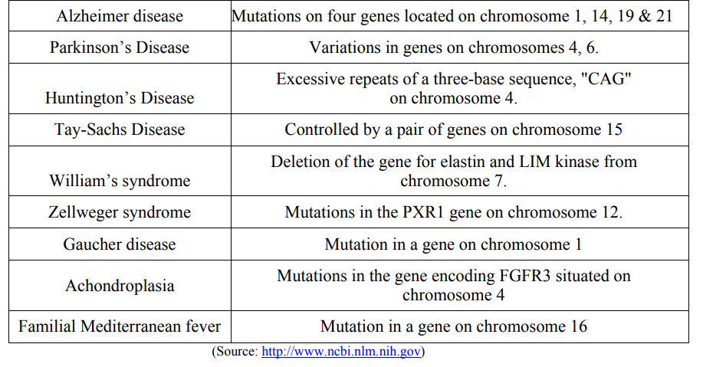

Slide 87
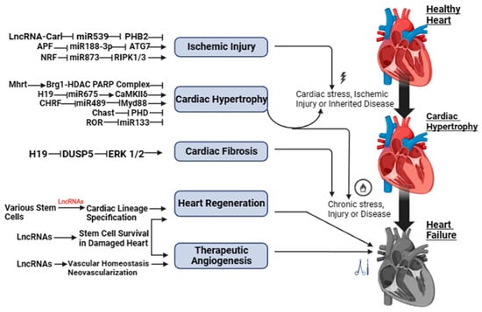
LncRNAs as possible therapeutic targets for heart failure

Slide 88
Jha, S.; Thasma Loganathbabu, V.K.; Kumaran, K.; Krishnasamy, G.; Aruljothi, K.N. Long Non-Coding RNAs (lncRNAs) in Heart Failure: A Comprehensive Review. Non-Coding RNA 2024, 10, 3. https://doi.org/10.3390/ncrna10010003

Slide 89
He X, Ou C, Xiao Y, Han Q, Li H, Zhou S. LncRNAs: key players and novel insights into diabetes mellitus. Oncotarget. 2017 Aug 4;8(41):71325-71341. doi: 10.18632/oncotarget.19921. PMID: 29050364; PMCID: PMC5642639.

Slide 90
Proteins
Proteins are the building blocks of cells. Most of the dry
mass of a cell is composed of proteins.
Proteins are very long chains of 20 possible amino acids
ACDEFGHIKLMNPQRSTVWY
(B,J,O,U,X,Z missing)
There are 20 different amino acids that form proteins. Out of these, we need to take 9 amino acids through our diet as we cannot synthesize them. These are called essential amino acids

Slide 91
Protein Functions
(a) form the structural components
(e.g., skin proteins)
(b) catalyze chemical reactions (e.g., enzymes)
(c) transport and store materials
(e.g., hemoglobin)
(d) regulate cell processes (e.g., hormones)
(e) protect the organism from foreign invasion (e.g., antibodies)

Slide 92
Proteins
Proteins are macromolecules, made by stringing together a chain of amino acids. A typical protein contains 200–300 amino acids, but some are much smaller (30–40 amino acids) and some are much larger (the largest ones reaching tens of thousands of amino acids).
Proteins can thus be read as one-dimensional objects, but do not have a linear form in the cell: the amino acids chain rapidly folds itself into the three-dimensional shape that ultimately determines its function.
Even small errors in the amino acid sequence can result in altered protein shape and performance, while major disruptions to their structure are likely to completely abolish function.

Slide 93
Primary Structure
The simplest level of protein structure, primary structure, is simply the sequence of amino acids in a polypeptide chain. For example, the hormone insulin has two polypeptide chains, A and B, shown in diagram below. (The insulin molecule shown here is cow insulin, although its structure is similar to that of human insulin.)
Each chain has its own set of amino acids, assembled in a particular order. The insulin chains are linked together by sulfur-containing bonds between cysteines.

Slide 94

Hormone Insulin Protein (Cow)
To help maintain their structures, the polypeptide chains in such proteins are often stabilized
by covalent cross-linkages. These linkages can either tie two amino acids in the same
protein together, or connect different polypeptide chains in a multisubunit protein.

Slide 95

Protein Structure
The amino acid sequence makes up the primary structure of the protein, however, the chemical/biological properties of the protein are very much dependent on the three-dimensional or tertiary structure.
The overall three-dimensional shape of an entire protein molecule is the tertiary structure. The protein molecule will bend and twist in such a way as to achieve maximum stability or lowest energy state.

Slide 96
Genome Sequencing
The DNA molecule is made up of two complementary strings. It does not matter which strand is sequenced because the sequence of the other strand can be derived.
Sequencing projects involve obtaining multiple redundant, overlapping sequences about 500 bases long from both strands of a given DNA molecule. Computer scientists are primarily concerned with assembling these fragments into longer sequences called contigs.

Slide 97
Genome Sequencing
mRNA molecules are collected from cells by biologists, and their sequences are copied biochemically into more chemically stable DNA molecules called cDNAS or complimentary DNAs.
Often a random redundant set of cDNA is sequenced to give a set of sequence fragments called expressed sequence tags (ESTs). ESTs are thus partial sequences of cDNA copies. ESTs are assembled into contiguous sequences (contigs) that represent individual cDNA sequences and the mRNA sequences from which the cDNAs were derived. Additional sequences may be obtained in the laboratory to fill in gaps.
PCR, or polymerase chain reaction, is a method for amplifying a specific region of a DNA fragment using DNA polymerase and short primer sequences to delimit the amplified region.

Slide 98
Genome Sequencing
Assembled sequences are edited to a level of accuracy of 99.99% ( 1 error or less per 10,000 positions, this level of accuracy is sufficient for most sequence analysis applications such as sequence comparisons, pattern searching, and translation) and stored in a computer file along with identifying features, such as DNA source (organism), gene name, and investigator.
There are a number of different sequence formats in use.
The stored DNA sequences of an organism usually represent a single sequence averaged over several individuals, strains , or races

Slide 99
Sequencing Machines
Small-scale PCR (Polymerase Chain Reaction) and Sanger sequencing (1977, Frederick Sanger) have been replaced by NGS machines.
NGS became available at the beginning of the 21st century. Perhaps the biggest advance that NGS offered was the ability to produce a huge amount of data, alongside its ability to provide a highly efficient, rapid, low-cost approach and accurate DNA sequencing, beyond the reach of traditional Sanger methods.
Illumina controls 75% of this market with its closest competitor Thermo Fisher.

Slide 100
FUNCTIONAL GENOMICS

Slide 101
What is functional genomics?
Functional genomics is the study of how genes and intergenic regions of the genome contribute to different biological processes. A researcher in this field typically studies genes or regions on a “genome-wide” scale (i.e. all or multiple genes/regions at the same time), with the hope of narrowing them down to a list of candidate genes or regions to analyse in more detail.
The goal of functional genomics is to determine how the individual components of a biological system work together to produce a particular phenotype. Functional genomics focuses on the dynamic expression of gene products in a specific context, for example, at a specific developmental stage or during a disease.

Slide 102

Functional Genomics Approaches
DNA level (genomics and epigenomics)
RNA level (transcriptomics)
Protein level (proteomics)
Metabolite level (metabolomics)

Slide 103
Functional Genomics Case Studies
Why do some cancer drugs only work effectively on a subset of patients with the disease?
Why are some cultivars of rice more resistant to drought than others?
What makes some individuals more susceptible to skin allergies?

Slide 104
Drug Discovery
The first step in the drug discovery pipeline is the characterization of the disease process and identification of drug (‘therapeutic’) targets. Here, a ‘target’ is defined as a protein or messenger RNA which, when modified by a drug, favourably affects the outcome of a disease.
In traditional drug discovery pipelines, less than 10% of candidate targets turn out to be valid after the investment of millions of dollars and six to seven years of work . More than 50% of drugs fail at phase II clinical trials due to the lack of efficacy, i.e. the drug is not harmful to humans, binds to the intended target and has drug-like properties (e.g. a reasonable half-life in the human body), but it does not significantly affect the disease.

Slide 105
Using Functional Genomics to Guide Drug Discovery
The pharmaceutical industry is keen on reducing the staggering rate of failure for targets in the drug discovery pipeline. One approach is to improve the identification and selection of potential targets, so drug development teams can focus on more hopeful candidate targets from the beginning. In this respect, results from many types of functional genomics experiments can provide information or evidence for the relationship between potential targets and their associated disease at the:
DNA level (single nucleotide polymorphism (SNP) and copy number variations, epigenetics)
RNA level (gene expression microarrays and RNA-seq)
protein level (DNA/RNA-protein interactions e.g. ChIP-seq)

Slide 106
Functional Genomics in Cancer Studies
Using functional genomics to guide drug discovery has been particularly useful for cancer studies. For example the discovery that the gene HER2 is over-expressed in certain types of breast cancers led to the development of the drug Herceptin (The HER2 Journey). More recently, high throughput analyses and meta-analyses of data from breast cancer samples have uncovered many additional targets for which existing drugs can be re-purposed, significantly speeding up the process of drug discovery

Slide 107
The Open Targets Platform
The Open Targets Platform integrates over 20 different public data sources, and uses this data to systematically build and score associations between drug targets and diseases.
Users investigating particular associations can rapidly sift through all the available evidence from genetic associations, somatic mutations, pathways and systems biology, RNA expression, animal models, the literature, and drug compounds. The Platform also provides a range of annotation information for targets, diseases, phenotypes, and drugs, and their most relevant relationships.
The Platform is an open access and open source tool. The code and data are freely available for academic and commercial use

Slide 108
Common Study Types in Functional Genomics
Functional genomics experiments measure changes in the DNA (genome and epigenome), RNA (transcriptome), or interactions between DNA/RNA and proteins that influence the phenotype of a sample. Common branches of functional genomics include-
genotyping
transcription profiling
epigenetic profiling
nucleic acid-protein interactions
meta-analysis

Slide 109
Transcription Profiling
This is one of the most popular study types, also known as ‘expression profiling’. It involves the quantification of gene expression of many genes in cells or tissue samples at the transcription (RNA) level. Quantification can be done by collecting biological samples and extracting RNA (in most cases, total RNA) following a treatment or at fixed time-points in a time-series, thereby creating ‘snap-shots’ of expression patterns.
For common reference genomes with well-annotated transcripts and genes (e.g. the human genome), a researcher can choose to focus on quantifying transcription of all or a subset of transcripts, genes, coding exons, non-coding RNA, and so forth.

Slide 110
Genotyping
Genotyping studies are those which identify differences in the DNA sequence (i.e genotype) of a sample. The genomic DNA samples are often obtained from two contrasting groups of samples, e.g. drought-resistant rice cultivars vs. drought-sensitive counterparts, with the aim of identifying differences in the genotype which may explain the difference in phenotype.
Genotyping studies can be designed to identify DNA sequence differences at three levels:
Single nucleotide polymorphisms (SNPs, pronounced ‘snips’): SNP analysis focuses on differences in the DNA sequence at the single nucleotide level.
Example: SNP 6.0 profiling of plasma DNA in breast cancer patients
Copy number variations (CNVs): CNVs refer to an increase or decrease in the number of copies of a segment of DNA (e.g. a gene, or a locus-specific DNA repeat element). Each ‘copy’ can be as short as 50 bases or up to 100 kilobases.
Example: A genome-wide copy number variant study of suicidal behaviour
Structural variations: they are an order of magnitude larger than CNVs and often cover megabases of DNA, and can be caused by chromosomal rearrangement events.
Example: Transcription profiling by high throughput sequencing of different maize lines to discover and characterise ‘presence-absence variation’ in the maize genome

Slide 111
Genome-Wide Association Studies (GWAS)
One common extension of genotyping studies in humans are genome-wide association studies (GWAS). Samples from cases (e.g. rheumatoid arthritis patients) and controls (e.g. healthy individuals) are genotyped across specific sites in the genome, followed by statistical analysis to find SNPs which are significantly more prevalent in one group (e.g. the disease cases). Such SNPs may then suggest an association between the SNPs and disease susceptibility.

Slide 112
Epigenetic Profiling
Epigenetics is the study of how biochemical modifications or physical interaction of DNA/chromatin affect gene regulation in a cell, where such modifications/interactions are not related to changes in the underlying DNA sequence.
At the DNA level, methylation of CpG dinucleotides.
At the chromatin level, modifications of the tails of histone proteins.

Slide 113
DNA/RNA-Protein Interactions
DNA/RNA-protein interactions are vital molecular processes where proteins bind to DNA or RNA, controlling fundamental cellular functions like gene expression, replication, and translation.
Modern techniques, including ChIP-seq for DNA and RIP-seq for RNA, are used to identify and study these interactions in cells.

Slide 114
Meta-Analysis
Meta-analysis is a branch of functional genomics in which data from pre-existing experiments is combined to create statistically more powerful models of a biological process. This type of analysis has become popular as it allows the identification of subtle events that could not be detected in smaller studies.
Functional genomics databases such as ArrayExpress in Biostudies and Expression Atlas play an important role in these studies as reliable, well annotated sources of functional genomics data.

Slide 115
Designing Functional Genomics Experiments
Three important things to consider when designing a functional genomics experiment are:
scale and intent
data analysis
reproducibility

Slide 116
Scale and Intent of the Experiment
The scale of an experiment encompasses both the number of samples and the number of genes to be analysed .
The number of samples is often a trade off between:
the number of replicates required to produce statistically robust results , (ii)the ease of obtaining the samples, (iii)the budget for the project
The scale and intent of the experiment will influence the methods used in the study:
Real-time PCR analysis is well suited to studies that aim to analyse a small number of genes in a small number of samples (for example, the change in expression of ten genes between two conditions)
Microarrays are a high-throughput technique to monitor the expression of all the genes already known in a given genome. They have been vastly used to study gene expression before the introduction of RNA-sequencing.
RNA-sequencing (RNA-seq) using next generation sequencing (NGS) is the current standard for high-throughput gene expression studies. By sequencing all the transcripts present in the samples (cell, tissue, whole organism, soil samples, etc)

Slide 117
Data Analysis
Although data analysis only happens after the wet-lab experimental procedures are performed, it is a very important aspect of the design of all functional genomics experiments and should be considered before embarking on the wet-lab procedures.
Some important things to consider while planning your experiment are:
How are you going to analyse your data?
Is special software required? Is it free or does it need a licence?
Is extra information needed? For example, a reference genome for aligning RNA-seq reads?
Is bioinformatics expertise required?
What are the hardware (storage and computational processing) requirements?
What are the most appropriate statistical tests and has the experiment been designed so that you can use them?

Slide 118
Functional genomics Common technologies and data analysis methods
Many different types of technologies can be used in functional genomics experiments, ranging from real-time PCR to high-throughput such as microarrays and next generation sequencing.
The type of technology that you choose to use will depend on the scale and intent of your experiment.
Real-time PCR is more suited to the analysis of a small number of genes while microarrays and next generation sequencing technologies can analyse thousands of genes simultaneously. Next generation sequencing also has the added advantage in that it allows the discovery of new genes and transcripts.

Slide 119
Real-time PCR
It is more sensitive than microarrays in detecting small changes in expression but requires more input RNA.
It is best suited for studies of small subsets of genes.
It's one major shortcoming is that the sequence of the specific target gene of interest must be known (so you can design the PCR primers), hence real-time PCR can only be used for studying known genes.
The first step in a real-time PCR reaction is the conversion of RNA to complementary DNA (cDNA) – this process is known as reverse transcription.
The next step uses fluorescent reporters and a PCR reaction to amplify and detect specific genes .

Slide 120
Microarrays
Microarrays are a collection of DNA probes that are usually bound in defined positions to a solid surface, such as a glass slide.
Labelled single-stranded DNA or antisense RNA fragments from a sample of interest are hybridised to the DNA microarray under high stringency conditions.
The amount of hybridisation detected for a specific probe is proportional to the number of nucleic acid fragments in the sample.

Slide 121
Microarray Principle
mRNA is an intermediary molecule which carries the genetic information from the cell nucleus to the cytoplasm for protein synthesis.
Whenever some genes are expressed or are in their active state, many copies of mRNA corresponding to the particular genes are produced by a process called transcription.
These mRNAs synthesize the corresponding protein by translation. So, indirectly by assessing the various mRNAs, we can assess the genetic information or the gene expression.
Since mRNA is degraded easily, it is necessary to convert it into a more stable cDNA form. Labeling of cDNA is done by fluorochrome dyes Cy3 (green) and Cy5 (red).
The principle behind microarrays is that complementary sequences will bind to each other.

Slide 122

How does a DNA microarray work?

Slide 123
How does a DNA microarray work?
To determine whether an individual possesses a mutation for a particular disease, a scientist first obtains a sample of DNA from the patient's blood as well as a control sample - one that does not contain a mutation in the gene of interest.
The researcher then denatures the DNA in the samples - a process that separates the two complementary strands of DNA into single-stranded molecules.
The next step is to cut the long strands of DNA into smaller, more manageable fragments and then to label each fragment by attaching a fluorescent dye .
The individual's DNA is labeled with green dye and the control - or normal - DNA is labeled with red dye.

Slide 124
How does a DNA microarray work?
Both sets of labeled DNA are then inserted into the chip and allowed to hybridize - or bind - to the synthetic DNA on the chip.
Then the target DNA fragments along with complementary sequences bind to the DNA probes. The remaining DNA fragments are washed away.
If the individual does not have a mutation for the gene, both the red and green samples will bind to the sequences on the chip that represent the sequence without the mutation (the "normal" sequence).
If the individual does possess a mutation, the individual's DNA will not bind properly to the DNA sequences on the chip that represent the "normal" sequence but instead will bind to the sequence on the chip that represents the mutated DNA.

Slide 125

One-colour or two-colour arrays?

Slide 126

Within a dual-color microarray, the probe DNA is typically hybridized with cDNA prepared
from two different samples, each labelled with a different fluorescent probe. Analysis will
yield green fluorescence for one sample that upregulates gene expression, whereas the
other sample tagged with a red fluorescence marker will indicate that the other condition
elicits gene expression at that location. Yellow indicates gene expression in both samples.

Slide 127
Analysis of microarray data
feature extraction
quality control
normalisation
differential expression analysis
biological interpretation of the results
submission of data to a public database (ArrayExpress collection in BioStudies or Gene Expression Omnibus GEO)
Microarrays have been the standard for high-throughput gene expression studies before the introduction of RNA-sequencing, in the first half of the 2010s. While RNA-seq has replaced microarrays for most transcriptional profiling studies, DNA chips are still in use: an example is the Single Nucleotide Polymorphism (SNP) array used in diagnostics.

Slide 128
Animations
DNA Microarray Animation
https://www.youtube.com/watch?v=xBr2qznEaqw
Single Cell RNA Sequencing Animation
https://www.youtube.com/watch?v=uFrrKHB9weY

Slide 129
Next Generation DNA Sequencing
Advantages of NGS
NGS can be used to analyse DNA and RNA samples and is a popular tool in functional genomics. In contrast to microarray methods, NGS-based approaches have several advantages including:
a priori knowledge of the genome or genomic features is not required
it offers single-nucleotide resolution, making it possible to detect related genes (or features), alternatively spliced transcripts, allelic gene variants and single nucleotide polymorphisms
higher dynamic range of signal
requires less DNA/RNA as input (nanograms of materials are sufficient)
higher reproducibility

Slide 130
Second-Generation Sequencing
SGS was developed in the early 2000s and became common use in DNA and RNA sequencing experiments around 2010s
SGS methods are characterised by different underlying technologies, but they all include the following:
DNA fragments have to be amplified through PCR prior to sequencing; this step is carried out on the sequencing slide. This is essential for signal detection
The reads produced are shorts, with a range from 70 to a few hundred base pairs
They are all ‘sequencing-by-synthesis’ technologies, with a signal generated for each nucleotide added

Slide 131
SGS technologies
Illumina (Solexa) sequencing: Illumina sequencing works by simultaneously identifying DNA bases, as each base emits a unique fluorescent signal, and adding them to a nucleic acid chain
Roche 454 sequencing: This method is based on pyrosequencing, a technique which detects pyrophosphate release, using light signal (bioluminescence), after nucleotides are incorporated by polymerase to a new strand of DNA. Roche 454 sequencing platform has been discontinued since 2016.
Ion Torrent: Proton / PGM sequencing: Ion Torrent sequencing measures the direct release of H+ (protons) from the incorporation of individual bases by DNA polymerase and therefore differs from the previous two methods as it does not measure light.

Slide 132
Third-generation sequencing
The first paper deploying TGS sequencing was published in 2009. However, TGS gained momentum only in the later 2010s; this is mostly due to third-sequencing technologies initially presenting lower accuracy than second-generation ones, an issue that HiFi sequencing from PacBio has recently overcome.
The distinguishing feature of TGS is that it is a single-molecule sequencing technology, i.e. the DNA amplification step essential for the previous generations is not required. TGS ‘reads’ the DNA molecule, allowing for faster sequencing and longer reads generation (in the range of kilobases).

Slide 133
TGS Technologies
Nanopore Sequencing, which is based on membrane current alterations generated by nucleotides of a DNA strand as they pass through a membrane nanopore: each nucleotide produces a specific change in current, allowing for the DNA molecule to be ‘read’. This is the sequencing method used by Oxford Nanopore.
SMRT (Single Molecule Real Time) sequencing, which takes advantage of zero-mode waveguide technology to perform sequencing by synthesis of single DNA molecules; this is the sequencing method used by HiFi PacBio.

Slide 134

Nanopore Sequencing

Slide 135

SMRT (Single Molecule, Real-Time) Technology

Slide 136
Improvements on the Previous Technology
Sample size : Needs significantly less DNA
Speed : NGS is massively parallel, allowing 300Gb of DNA to be read on a single run on a single chip.
Cost : Using modern Sanger sequencing methods, aided by data from the known sequence, a full human genome would still cost £6M. Sequencing a human genome with Illumina today would cost less than £1,000.
Accuracy : Repeats are intrinsic to NGS, as it relies on many short overlapping reads (or longer overlapping fragments in the case of TGS), so each section of DNA or RNA is sequenced multiple times. Also, because it is so much quicker and cheaper, it is possible to do more repeats than with Sanger sequencing. More repeats means greater coverage, which leads to a more accurate and reliable sequence, even if individual reads are less accurate for NGS.

Slide 137

RNA Sequencing

Slide 138

Design Considerations
Library Preparation –
One important aspect is choosing which population of RNA will be converted to a cDNA library. Using total RNA allows detection of non-coding as well as mRNAs
Sequencing can involve single-end (SE) or paired-end (PE) reads. Paired-end sequencing means sequencing both ends of the cDNA fragments and aligning the forward and reverse reads as read pairs. Paired-end reads are preferable for de novo transcript discovery.

Slide 139
Sequencing Depth or Library Size
Sequencing depth or library size refers to the number of sequenced reads for a given sample. As the sample is sequenced to a deeper level, the reads are likely to cover a larger proportion of the genome/transcriptome, allowing more transcripts to be detected with more precise quantification. Optimal sequencing depth depends on the aims of the experiment and on the complexity of the target transcriptome.

Slide 140

Number of Replicates
The number of replicates in an RNA-seq experiment depends on:
Technical variability in the RNA-procedures.
Biological variability of the system under study. Biological replicates are required if inference on the population is to be made, with three biological replicates being the minimum for any inferential analysis.
Desired statistical power, that is the capacity for detecting statistically significant differences in gene expression between experimental groups.

Slide 141
Library Preparation and Sequencing Approaches
Library preparation: a population of RNA (total or fractionated such as polyA⁺) is converted to a library of cDNA fragments with adapters (synthetic oligonucleotides of a known sequence) attached to one or both ends. Adapter-ligated cDNA fragments are then amplified in preparation for sequencing.
Sequencing and imaging: to obtain the nucleic acid sequence from the amplified library, each molecule is sequenced in a high throughput manner to obtain millions of short reads (sequences) from one end (single-end sequencing) or both ends (pair-end sequencing). The sequencing process usually generates millions of short (25-300 bp) reads with associated quality scores as FASTQ files

Slide 142

FASTQ Format

Slide 143
Data Analysis
Once sequencing is complete, raw sequence data (FASTQ files) must undergo several analysis steps. The exact methods vary depending on the experiment but include:
quality control
read alignment (with or without a reference genome)
quantification of gene and transcript expression
and detection of differentially expressed genes

Slide 144
Quality Control
This step involves pre-processing the data to remove:
adapter sequences (adapter trimming)
low-quality reads
uncalled bases
and to filter out contaminants (sequences which don’t derive from the source organism). It is important to check that sequence quality is similar for all samples and discard outliers
FastQC is a popular tool to perform quality assessment.

Slide 145
Read Mapping or Alignment
When studying an organism with a reference genome, it is possible to infer which transcripts are expressed by mapping the reads to the reference genome (genome mapping) or transcriptome (transcriptome mapping).
When working on an organism without a reference genome, reads need to be assembled first into longer contigs (de novo assembly). These contigs can then be considered as the expressed transcriptome to which reads are re-mapped for quantification.

Slide 146

Mapping reads to a reference or de novo assembly
Alignment tools
There are many bioinformatics tools available to perform the alignment of short reads. One of the first popular RNA-seq mappers was TopHat.
TopHat has now been superseded by HISAT2
Tools such as Picard or MultiQC can be used for quality control in mapping.

Slide 147
Quantification
The simplest approach to quantifying gene expression by RNA-seq is to count the number of reads that map (i.e. align) to each gene (read count) using programs such as HTSeqcount or featureCounts.
Raw read counts are affected by factors such as transcript length (longer transcripts have higher read counts, at the same expression level) and total number of reads. Thus, if we want to compare expression levels between samples, we need to normalise the raw read counts.
The measure RPKM (reads per kilobase of exon model per million reads) and its derivative TPM (transcripts per million) account for both gene length and library size effects.

Slide 148
Quantification

Slide 149
Quantification (RPKM)

Slide 150
Quantification (TPM)

Slide 151

RNA-seq processing pipeline used to generate gene expression data in Expression Atlas

Slide 152
Fold Change
logFC (Log Fold Change)
What it measures: The magnitude and direction of change in gene expression between two conditions (e.g., disease vs. control).
Scale: Logarithmic (usually log₂).
Example:
logFC = 1 → 2× upregulated
logFC = -1 → 2× downregulated
Interpretation:
logFC > 0 → Gene is upregulated
logFC < 0 → Gene is downregulated
logFC ≈ 0 → No significant change

